Slide 1
Blue Bell Aquatic Center
Future Needs of the BBAC

Slide 2
Programmatic Requirements
Initial research (late 1990s) by the City and the Citizen’s Steering Committee found a need for a community center that would ultimately include an outdoor leisure pool and indoor natatorium, a community education center, and a recreation center. Aside from aquatic and recreational needs, the multi-use complex for this site will ultimately serve a local youth organization and the Community Education Department of the Brenham Independent School District.

Slide 4
Design Solutions
The Blue Bell Aquatic Center Phase I was completed and opened in 2001 and includes an outdoor leisure pool comprised of a 5,500 square foot water area with a 120 ft. water slide, water floats and sprays (thematically designed around Blue Bell ice cream products), a zero-beach entry, and a children’s pool for young swimmers. The Natatorium houses a 6-lane, 25-yard pool for practice, training, and U.I.L. sanctioned competition. The addition of a childcare room, an exercise room, and a 1,000 square foot therapy/rehab pool with dressing rooms and an office/exam room to the original contract was made possible through additional private donations.

Slide 5
PHASE II
There was a Recreation Center in Phase II that was proposed to be built. From my understanding, instead of building phase II, the city opted to build the building next door, now known as the Boys & Girls Club. From Blue Prints, it appears that Phase II would have consisted of:
  • Outdoor Lazy River in the grass area between the leisure pool and the exterior fence
  • A second BIG slide in Leisure Pool intertwined in the current yellow slide
  • Additional parking currently where the Boys & Girls Club is currently located
  • Handicap Parking in the rear of the current building attached to the Recreation Center
  • Recreation Center – additional 14,930 sq ft building, attached to the current building consisting of lobby, 5 offices, additional storage, additional restrooms, laundry room, double basketball court, 2 racketball courts, serving room, completion of an indoor walking trail (hallways from aquatic center to recreation center).

Slide 7
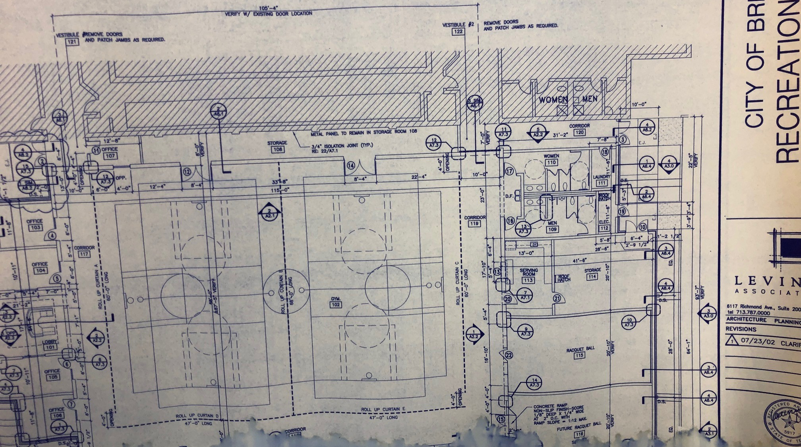
Restroom
Restroom
Office
Office
Serving Room
Storage
INDOOR BASKETBALL
Racketball
Office
Office
Racketball

Slide 8
Current Status
Currently as the City is looking at a Capital Improvement Plans leading us into 2025, we need to consider where we want the Blue Bell Aquatic Center to go, and/or does the community want it to grow? If we want to grow, what does that to look like?

Slide 9
Options to Consider
Staff is looking for your guidance and what you have heard in the community. We have heard several recommendations from our patrons which are listed. We have also heard the need to have better access to the therapy pool.
In order to move forward with our Capital Improvement Plan would like to know the Parks Boards take on whether we plan big or stay small and address some of the user’s requests. Due to the property layout we have to be careful with any improvements so we do not affect expansion options if Phase II is considered.

Slide 10
Building Phase II
Building Phase II or Parts of Phase II such as the Recreation Center with Indoor Basketball Courts, Racketball Courts, Cardio Machines, Sauna, additional restrooms, handicap parking, possibly a new water feature for the leisure pool area.
  o Splash Pad
  o Flow Rider
  o Additional Free-Standing Slides

Slide 11
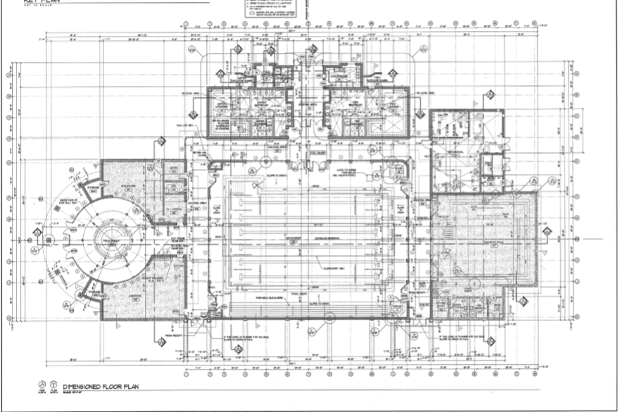
Women’s Locker Room
Men’s Locker Room
Pump Room
Chemical Storage
Competition Pool
Park Central
Therapy
Pool
Handicap / Staff Parking
Single restroom
Single restroom
Laundry
Storage/ Conference Room
Office
Outdoor Lap/Recreation Pool
8 lanes
3 ft - 10 ft water depth
Teens/Adult Swimming
Swim Teams
Sun Deck for sun bathers
Aerobic Classes
Decking / lounge chairs
Racketball / Indoor Pickleball Courts
(20 x40 ft)
Sauna
Decking / lounge chairs
Decking / lounge chairs
Racketball / Indoor Pickleball Courts
(20 x40 ft)
Additional Restroom / Shower
Racketball / Indoor Pickleball Courts
(20 x40 ft)
Decking / lounge chairs

Slide 13
Splash Pad Options

Slide 17
Any Suggestions??

