Slide 1
Washington County ESD 1
Creating & Organizing an
Emergency Services District

Slide 2
What is an Emergency Service District?
Emergency Services Districts (“ESD”) are local political subdivisions of the State created through public elections, that provide fire, rescue, EMS and other emergency services directly, or through contracts which help fund local fire and EMS departments
ESDs are governed by a Board of 5 commissioners who are most often appointed by the County, except in multi-county, or specific counties (ex: Harris) run by elected Boards
ESDs are primarily funded by property taxes of $0.10 per $100 of property valuation as determined by the constitution.
Example: On a $250,000 assessed valued home, the property owner would pay $250 on their county tax bill for the ESD’s $0.10/$100 tax rate

Slide 3
What’s the point?
FUNDING
ECONOMICS
COMMUNITIES
BENEFITS
ESDs provide a reliable funding source for local fire, and other emergency service responders, rather than depending inconsistent revenue sources
Many established ESDs have considerably reduced fire and EMS response times and consequently saved lives, properties and funds of local citizens
ESDs spread the cost of vital emergency services amongst all taxpayers within the district, and ensure all constituents may depend on reliable services when required
ESDs may work with existing volunteer fire departments or other entities that have full time fire & emergency personnel to provide services to the district’s constituents, helping local departments do what they do without the added stress of financial and organizational pressures
The formation of an ESD may also result in a better Insurance Services Office (ISO) rating within the ESD’s service area and therefore may provide lower insurance premiums for businesses and homeowners in that area

Slide 4
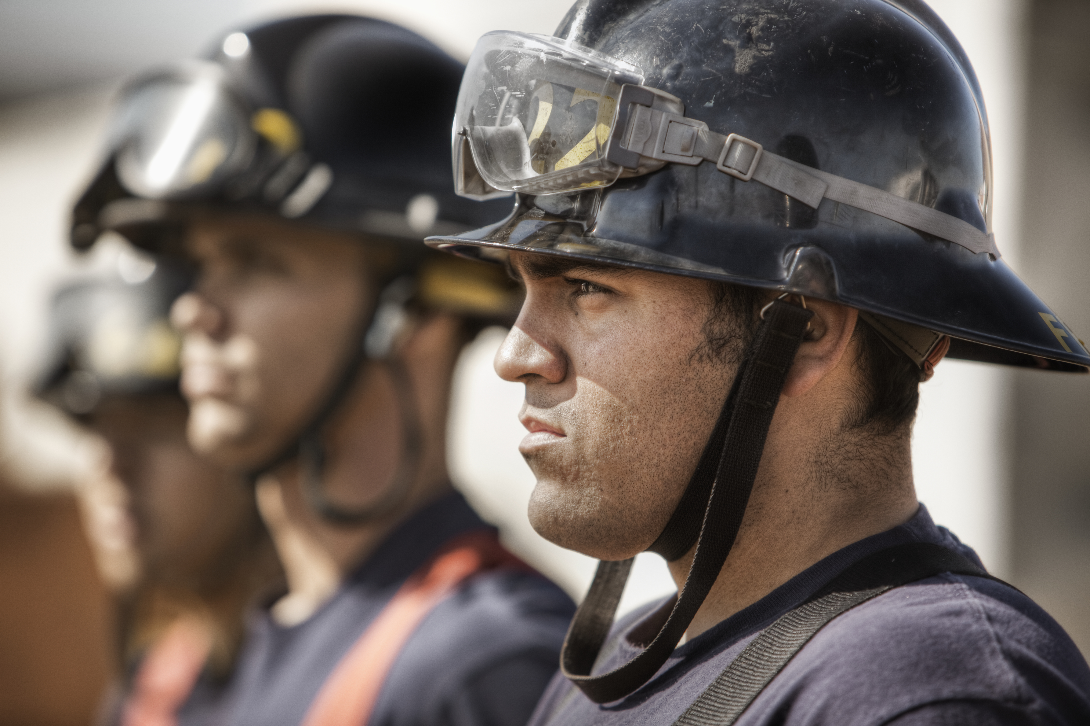
Who, what, why?
WHO you are, WHERE you are, and WHY it makes a Difference
YOUR Departments
YOUR Community
Calls & Response Times
These Departments work Hard for You. What can we do to make it easier on Them?

Slide 5
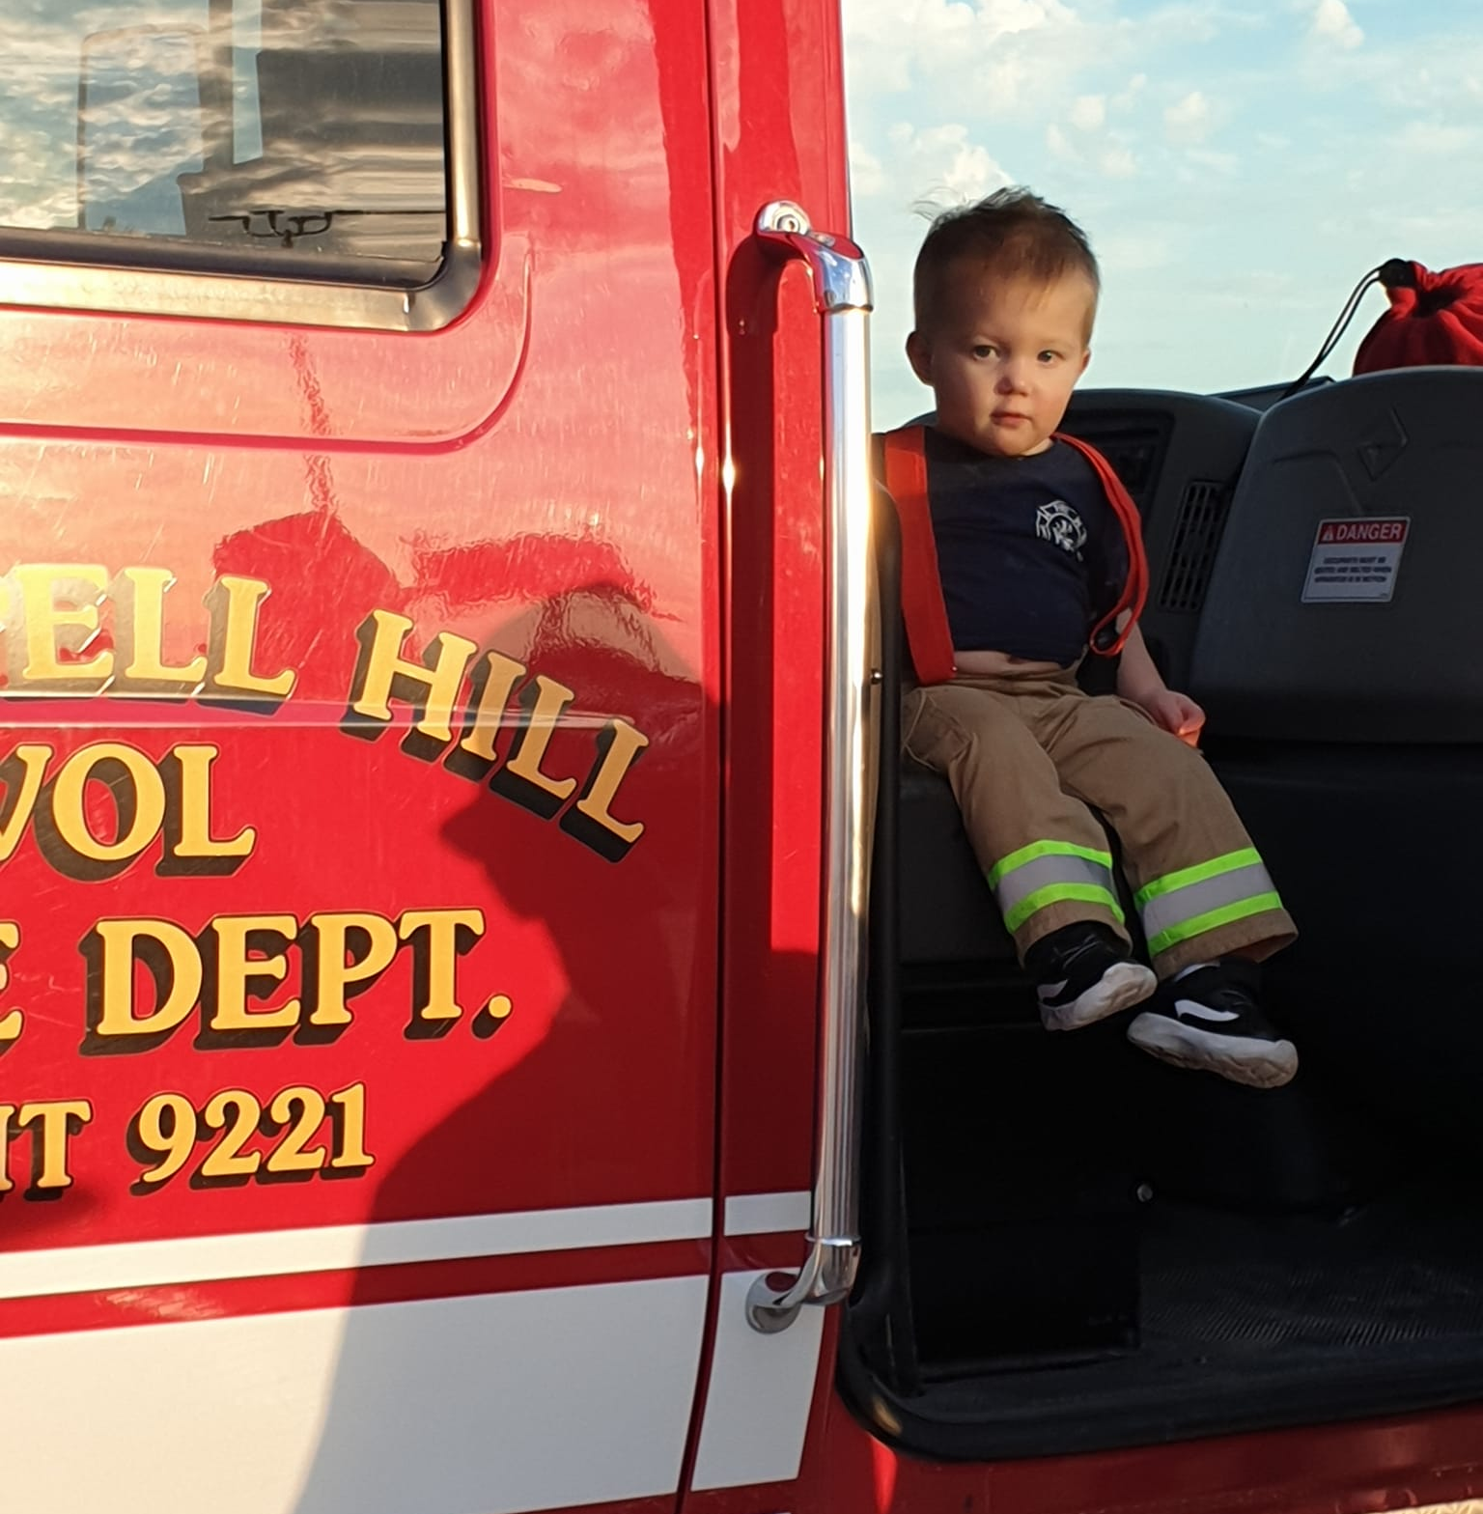
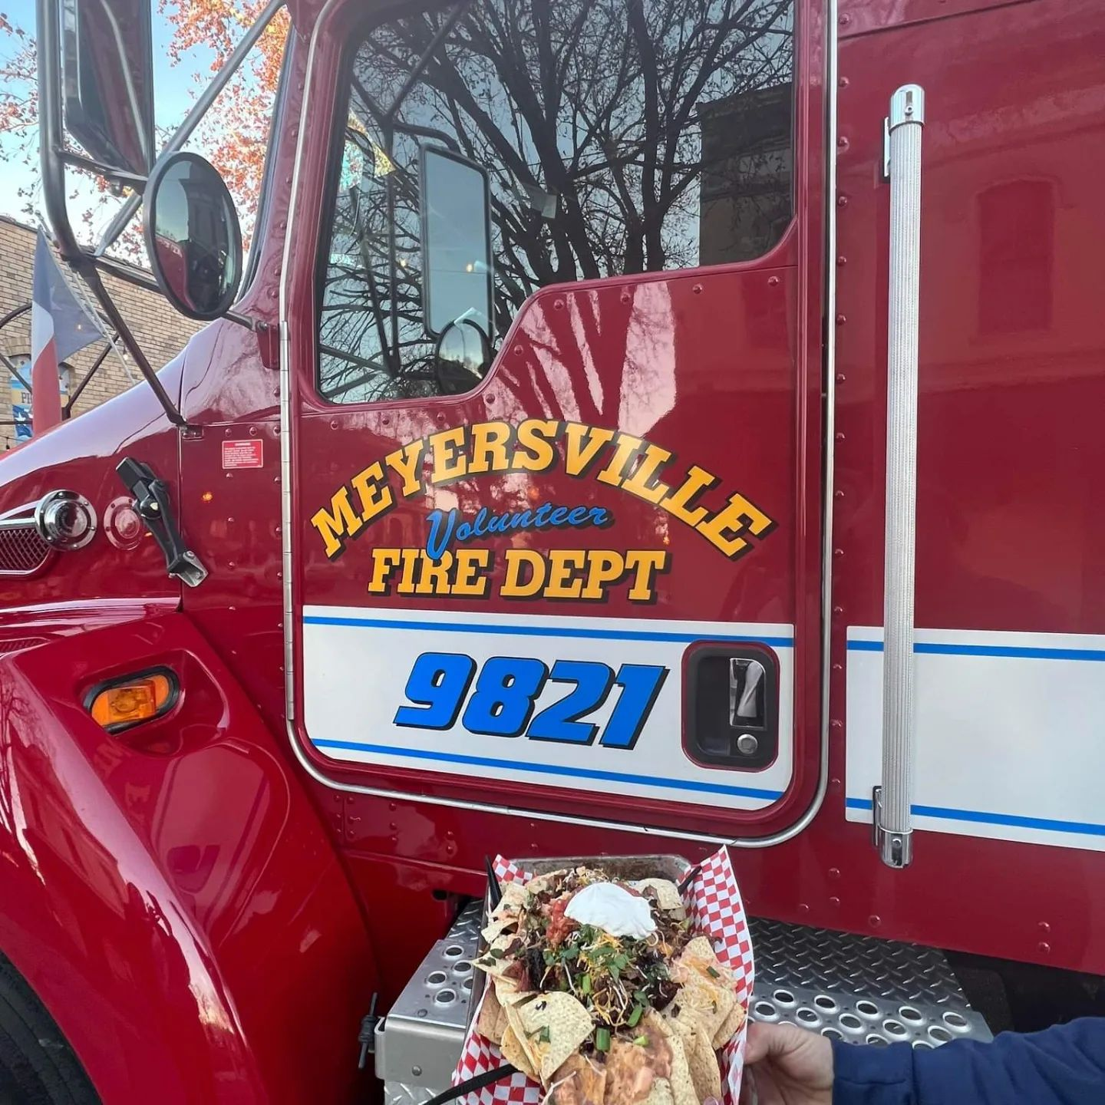
Serving the community
Getting to know your local VFDs
Chappell Hill VFD
Chappell Hill VFD was founded in 1974
They cover approximately 100 square miles, and serve an estimated 5,000 citizens
Run by Fire Chief Michael Kmiec
Made up of 21 volunteers, including command staff, firefighters, trainees, and general members.
Meyersville VFD
Meyersville VFD was founded in 1982
They cover approximately 47 square miles, and serve an estimated 2,100 citizens
Run by Fire Chief Trey Burleson
Made up of 19 volunteers, including command staff, firefighters, trainees, and
general members.
The formation of Washington County ESD 1 would help these departments continue operating successfully
by providing additional funding and equipment to better serve their communities, and allow for better
communication and cooperation with responses to emergency situations in the area.

Slide 6
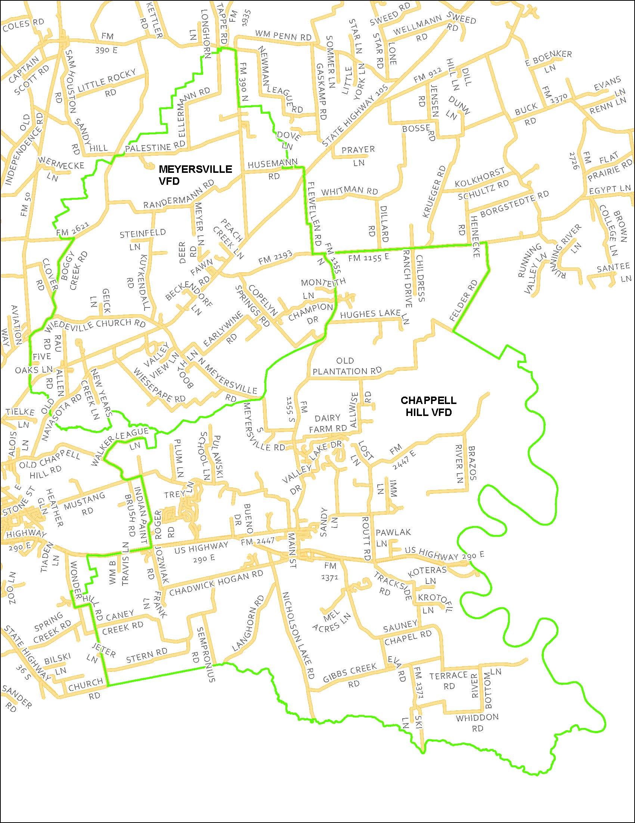
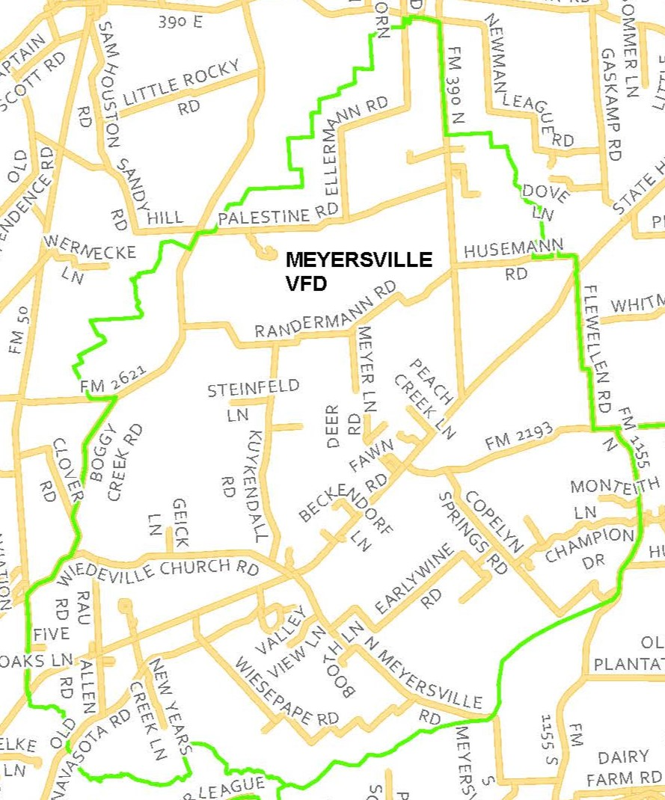
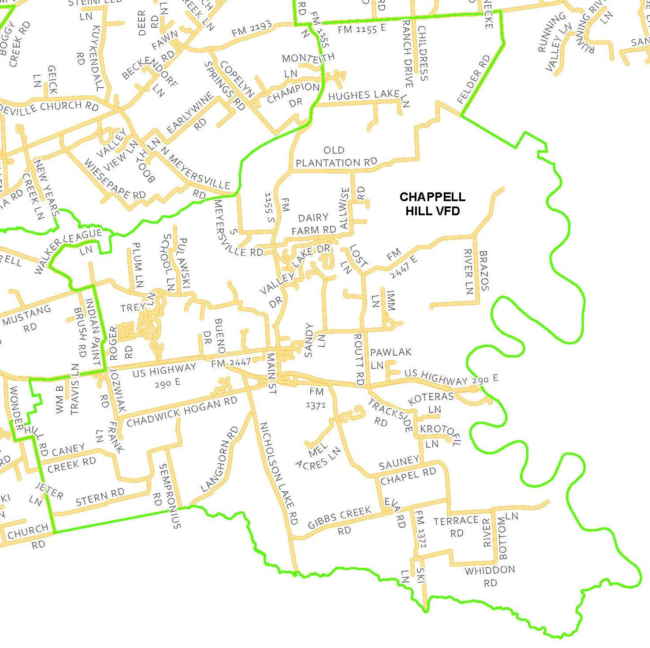
Proposed district boundaries
Meyersville VFD
Chappell Hill VFD
~ 47 Square Miles
~ 100 Square Miles
WASHINGTON COUNTY ESD 1

Slide 7
Call Volume Data from 2020 to 2024
In 2020, Chappell Hill VFD and Meyersville VFD responded to 117 calls
In 2021, they responded to a combined total of 194 calls
In 2022, the Departments made 365 total calls
In 2023, the Departments made 243 calls combined
SO FAR in 2024, the Departments have made 164 calls combined
Chappell Hill – 112 calls, as of June 2024
Meyersville –52 calls as of June 2024
On average, the highest number of emergency calls in the County are made related to:
Active grass fires, Car Crashes, Structural and Vehicle fires
Calls are also made for hazmat incidents, fire alarms, illegal burning, and other special assignments

Slide 8
How long do you want to wait? Why time matters in an emergency
Response times:
Current Average Response Time:
14 minutes 45 seconds (14:45)
Average Truck Turnout Time: 9 minutes 21 SECONDS (9:21) (Time it takes for a truck to leave the station, along with personnel turnout)
Working TURNOUT Goal is <5 minutes
98% call response time over 5 minutes were due to NO staff at the station
Average Time Per Call in 2024: 1 Hour, 22 minutes, 19 seconds (01:22:19)
Chappell Hill
Meyersville
CURRENT AVERAGE RESPONSE TIME:
15 MINUTES FORTY-ONE SECONDS (15:41)
AVERAGE TRUCK TURNOUT TIME: 6 MINUTES & THIRTY-ONE SECONDS (6:31)
(TIME IT TAKES FOR A TRUCK TO LEAVE THE STATION ALONG WITH PERSONNEL TURNOUT)
WORKING RESPONSE GOAL IS 8 MINUTES
98% OF INCIDENT RESPONSES HAD TURNOUT TIME OVER 8 MINUTES
DUE TO NO STAFF AT THE STATION
AVERAGE MAN HOURS PER CALL IN 2024: 2 HOURS, 22 MINUTES, 42 SECONDS (02:22:42)
How can forming an ESD help improve these times, and why does it matter?

Slide 9
Ideal response:
Can it be done, without more people, trucks, or funds?
Structure Fire - 1 engine with 4 personnel, 1 tender with 2 personnel, Chief/IC
Suggested requirements are 13 -16 personnel, 2 engines, 1 truck, IC, safety, and RIT)
Grass Fires- 1-2 boosters with 2-4 personnel, 1 tender with 2 personnel, Chief/IC
Car Fire - 1 engine with 4 personnel, 1 tender with 2 personnel
Crash w/ and w/o Entrapment - 1 engine with 4 personnel, 1 tender with 2 personnel, 1 rescue with 4 personnel, Chief /IC
Automatic Alarm - 1 engine with 4 personnel
Smoke Investigation - 1 booster with 2 personnel
Illegal Burn - 1 booster with 2 personnel

Slide 10
Where are you going? How do you get there?
Chappell Hill VFD
6-10 years??
3-5 years??
1-2 Years??
Replace Brush Truck
* Initiating a fleet replacement plan
Replace Water Tender
*Initiating a fleet replacement plan
Replacing Emergency Life Saving Equipment & PPE
Purchase Gear Decontamination System
Operational Costs
Retrofit SCBAs to meet NFPA
Replace Emergency Life Saving Equipment & PPE
Station improvements – add living quarters
Hire 2 paid duty-crew personnel
Operational Costs
Potentially Purchase Land For Station #2
Operational Costs
GOALS
COST
$710,482
$1,302,665
$1,895,112
How much is too much to save a life?

Slide 11
Where are you going? How do you get there?
Meyersville VFD
6-10 years??
3-5 years??
1 -2 years??
Replace Outdated Air Packs
New Bunker Gear/PPE
Replace Rescue Engine
*Initiating a fleet replacement plan
New Equipment for Rescue Engine
Operational Costs
Replace Brush Truck
*Initiating a fleet replacement plan
Replace Personal Protective Equipment
Replace Fire & Life Safety Equipment
Operational Costs
(*approximate cost unknown)
Replace Additional Personal Protective Equipment
Replace Command Vehicle
*Initiating a fleet replacement plan
Hire 2 paid duty-crew personnel
Operational Costs
GOALS
COST
$768,200
$1,129,248
$1,894,270
How much is too much to save a life?

Slide 12
strategic planning: needs & Goals
Why looking behind IS planning Ahead
Approximate MINIMUM Costs of 1-10 year Goals*
Chappell Hill VFD: $3,908,259
Meyersville VFD: $3,791,718
Cost of vehicles & apparatus continue to rise due to manufacturing, emissions standards, & supply shortages
Expired & outdated gear and equipment puts first responders in danger, and may cost someone their life
Ex: Air pack standards: 2013 (we have 2002)
New Radios & Tech allow for interagency cooperation and communication, and keep first responders safe
Outdated and worn-out Engines & Apparatus can’t meet the needs of growing territories, and represent continuous repair costs and safety hazards
Recommendation is to replace after 15 years [ours are at least 19 years old]
Basic Goal: at least meet the current standards set by SFFMA and other oversight Agencies

Slide 13
Potential Revenues of WC ESD:
Ad Valorem Tax Income
Chappell Hill VFD Territory – Current Value: $731,764,340
Meyersville VFD Territory – Current Value: $321,076,350
Based on a $0.10/$100 tax rate, anticipated revenue (with ag exemption) to be collected for the ESD would be about: $1,052,840 on an Annual basis
Yearly ad valorem Revenue income may fluctuate based on changes in annual assessed property valuations calculated by Washington County Tax Assessor.
Some Exemptions including Veteran Disability and Agriculture are determined by the county or state and are not subject to ESD INPUT
ESDs are funded primarily through ad valorem (property) and sales/use taxes, however they may also grant yearly TAX exemptions including:
= $1,052,840,690*
HOMESTEAD
AGE (OVER 65)
DISABILITY
Other potential revenue may also exist if a sales and use tax is levied by the District

Slide 14
Property Tax Exemptions:
Realistic Annual Revenue Expectations
Exemptions granted by an ESD are in addition to State and County exemptions, including Veteran Disability & Agriculture Exemptions
Agriculture Exempt
properties are only taxed on value after exemptions are calculated by WCAD
Ex: if a Total Property Value = $17,859,280, with agriculture loss =$17,433,650, then taxable = $425,630
$0.05/$100 = $212.82/year to ESD (up to) $0.10/$100 = $425.63/year to ESD
$425,630/100 = $42,563 x 0.05 = $212.82 $425,630/100 = $42,563 x 0.10 = $425.63
Properties with NO Ag. Exemptions are taxed by the ESD on the total homestead market value, or based on other exemptions
Properties with 100% Ag Exemptions are fully exempt from ESD ad valorem taxation
Homestead -
An ESD may offer a maximum 20% exemption on taxable home values for Homesteaders, which may not be claimed on parts of property already subject to agricultural exemptions
Disability
– An ESD may offer tax exemptions based on an individual’s disability status, which may be combined with homestead exemptions for the same individual, but may not be combined with Age status
Age (Over 65)
- An ESD may offer tax exemptions for individuals over the age of 65, which may be combined with homestead exemptions for the same individual, but may not be combined with Disability
Exemption Rates are set on an annual basis and often vary based on changing property valuations assessed by the
County Appraisal District and Tax Assessor.

Slide 15
what’s the point? Where’s my benefit?
First responders save lives, but they need equipment to do that.
Provide FUNDING to repair, update, or replace aging apparatuses
Repairs are $$$! just replacing pump on booster truck– average cost is between $7-$12k
Current trucks hold little to no resale value, and are expensive to replace
Allow for ECONOMIC replacement of apparatuses on a scheduled basis, reducing unexpected needs
ISO and NFPA suggest front line apparatuses be replaced after 15 years
Allows for standardizing equipment across all engines for better interoperability, set up & function in emergencies
Provide funding for land purchases & building and remodeling fire stations to better serve the COMMUNITY, and meet the needs of firefighters and staff
(Sleeping quarters, showers, equipment storage, workout and meeting rooms, etc.)
Development of a volunteer retention program (paid per call) to recruit new volunteers & members, as well as potentially gaining paid personnel to staff stations during the day when volunteer levels are low, further reducing response times in emergency situations
They’re there for you. Who is there for them? Help Emergency Responders Help You.

Slide 16
Frequently Asked Questions!
Why is there not a county-wide ESD being tried?
Why are you not going to the county for additional funding?
Why is EMS not involved in this ESD?
Why are your agencies trying to do an ESD now?
Who can vote on the ESD?
Can you provide the amount of money a sales tax would provide?
How much would it cost to hire paid staff for both departments?

Slide 17
Any Questions?

