Slide 1
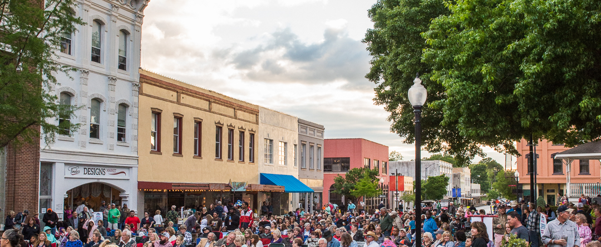
BS 36/SH 36 Traffic Mitigation Improvements
Notes:
SUMMARY STATEMENT:
In 2019 the Brenham City Council adopted a new Comprehensive Plan titled, Historic Past, Bold Future: Plan 2040 (Plan 2040). Plan 2040 included a large public input component on areas including transportation and roadway network. During the Town Hall on January 1, 2019 over 150 citizens packed the Brenham Nancy Carol Roberts Memorial Library and were tasked with working in small groups to provide feedback on the Thoroughfare Map by placing green dots on areas where changes were not needed, red dots on areas that need improved connectivity and a yellow dot on areas that need improve traffic flow. Of the ten groups participating, eight marked red or yellow dots in the area commonly referred to as the “four corners,” located between H-E-B and Lowe’s along Business 36 (S. Day St) and State Highway 36.
The feedback collected during the Town Hall was shared with the Texas Department of Transportation (TXDOT) for consideration during their regional Transportation Improvement Program. TXDOT subsequently evaluated crash data, service calls, and traffic counts for the area. Based on their findings, TXDOT developed a proposed traffic mitigation plan and hosted a public meeting in 2023 to present the proposed improvements and gather additional community input.
Since that meeting, TxDOT and City staff have made it a top priority to find a solution that addresses traffic and access management along both the Business 36 (S. Day St) corridor and State Highway 36 from the feeder road to Woodridge Boulevard, that considers safety and the feedback received, specifically designing a left turn option out of H-E-B but yet limiting numerous traffic maneuvers on Business 36 (S.Day St). With Brenham growing and increasing traffic year after year we believe that this needs to be looked at and possible action taken to make this area safer for all.
During the upcoming work session, City staff and Doug Marino, P.E., Director of Transportation Planning and Development for TxDOT, will deliver a presentation providing an update on the proposed traffic mitigation project for the area.
Since that meeting, TxDOT and City staff have prioritized developing a solution that improves traffic flow and access management along both the Business 36 (S. Day St) corridor and State Highway 36 (from the feeder road to Woodridge Boulevard). The plan emphasizes safety and incorporates public feedback, including a dedicated left-turn option from H-E-B, while minimizing excessive traffic movements on Business 36.

Slide 2


Slide 3
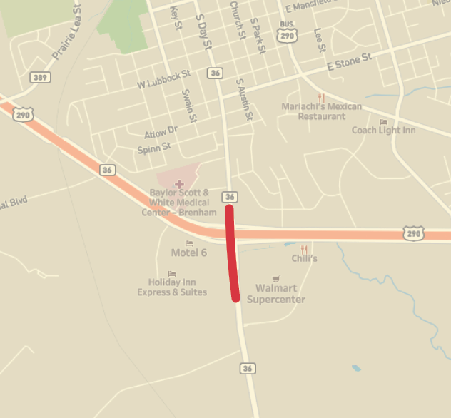
Project Information
Limits: On S. Day St. north of US 290 and SH 36 south of US 290
Contract Bid: December 2026 (Tentative)
Traffic Volume: ~20,000 vehicles/day
Project Scope:
  Reduce congestion
  Reduce crashes
  Limit access impacts to businesses
Project Start
Project End

Slide 4
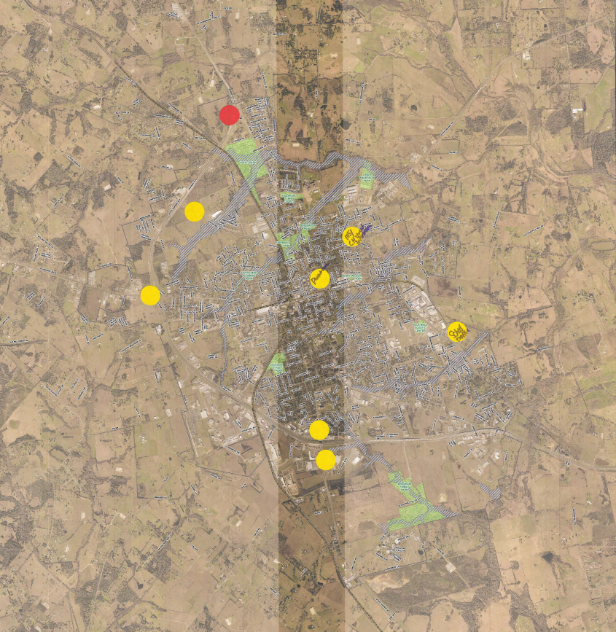
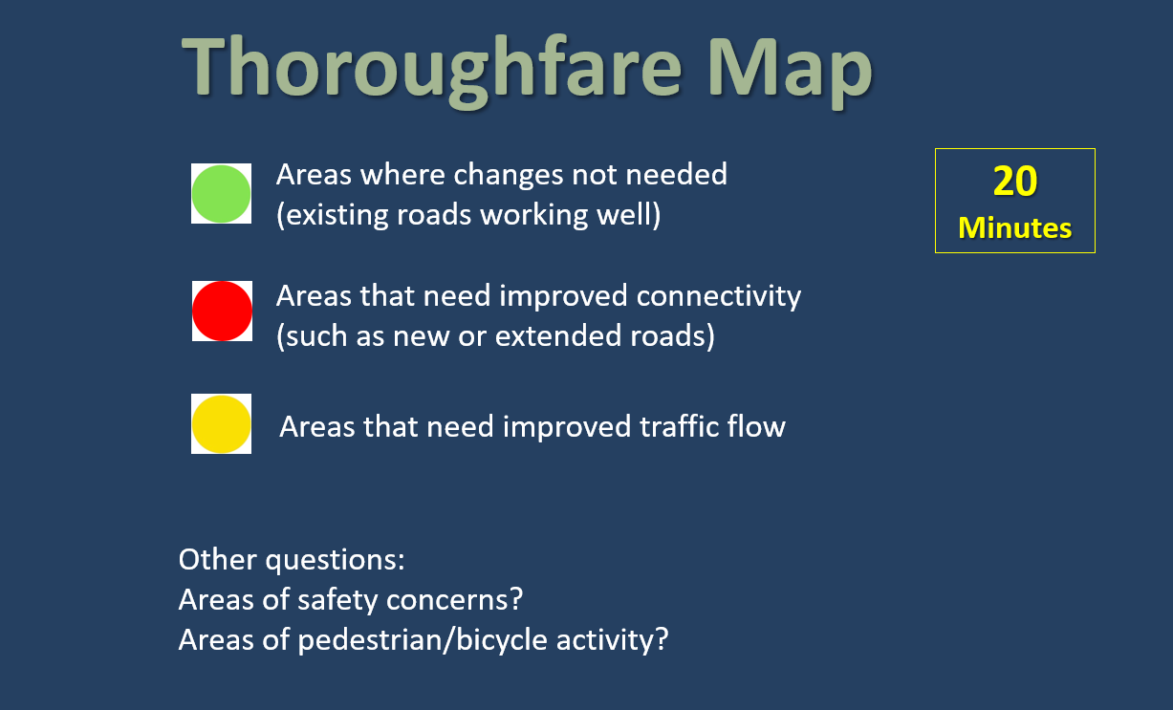
Background – Comprehensive Plan

Slide 5
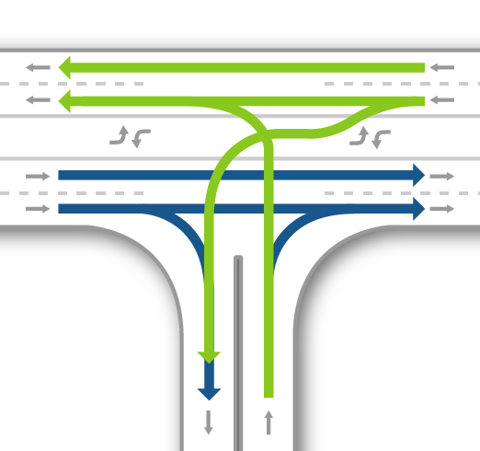
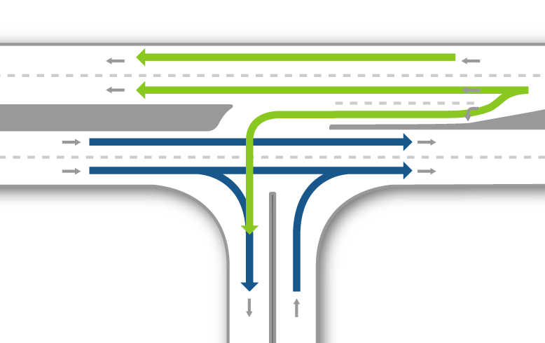
Raised Medians
Two-Way Left Turn Lane
Raised Median
Median Features:
Enhance safety by reducing conflict points where vehicles can collide
Improve traffic flow by providing dedicated turn lanes
Median Statistics:
Nationally – Raised medians have shown to reduce crashes by up to 27%
(1995 Study published in the Journal of Transportation Engineering)
Conflict Point Legend
CROSSING DIVERGING MERGING
Locally - Recent raised median projects have reduced crashes by up to 65%
(Texas Avenue and University Drive Projects)

Slide 6
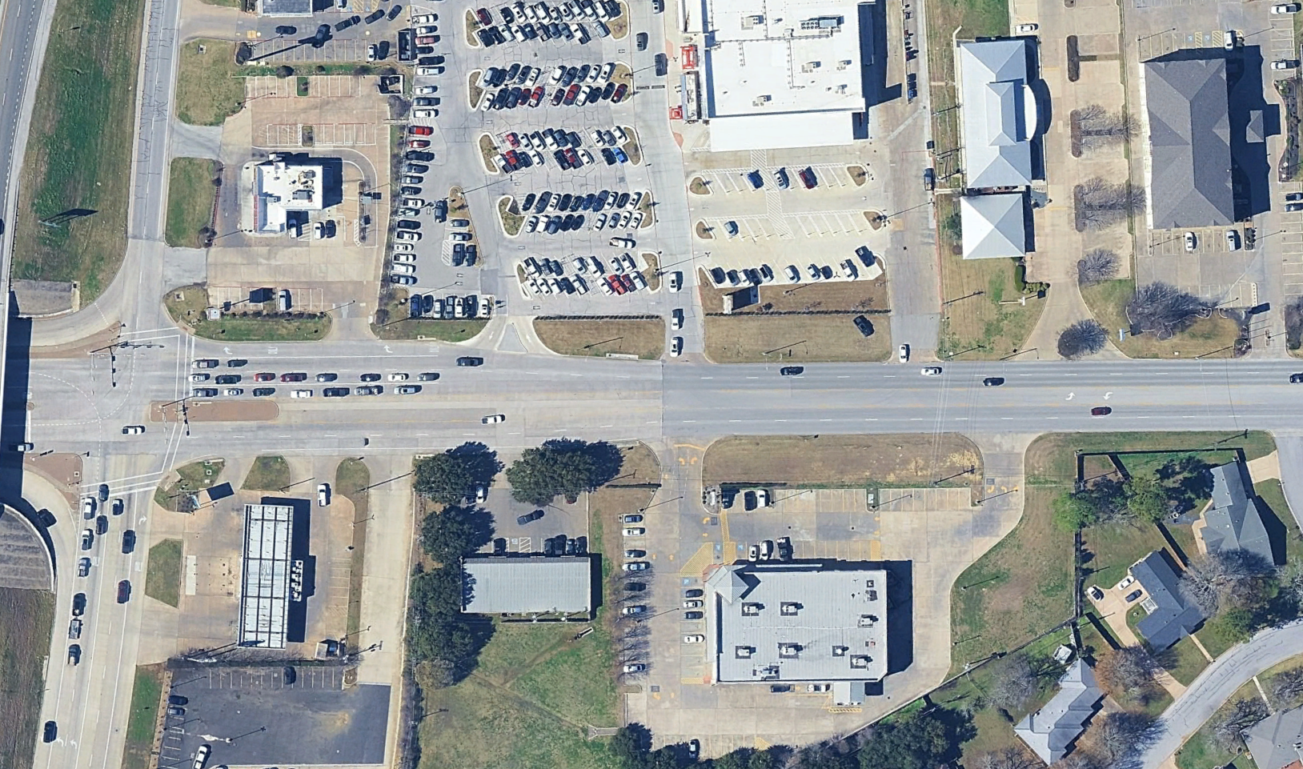

Current Roadway – South Day St.

Slide 7
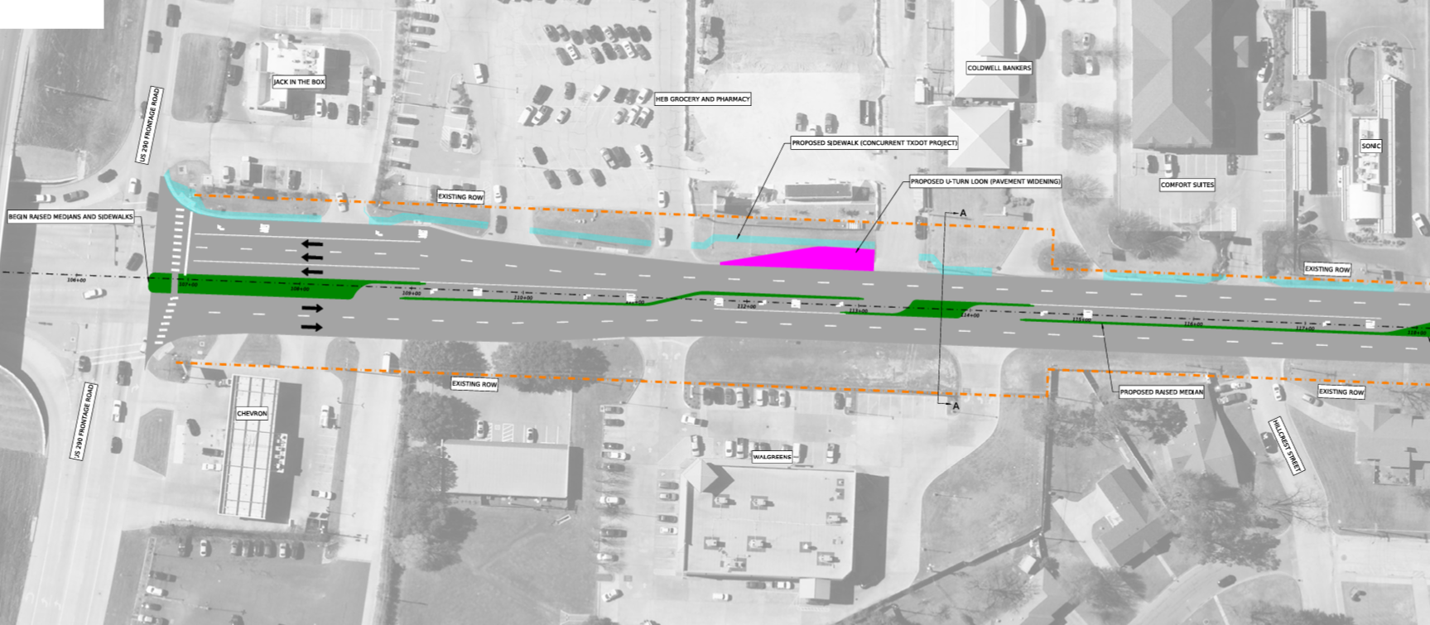
2023 Public Meeting Layout

Slide 8
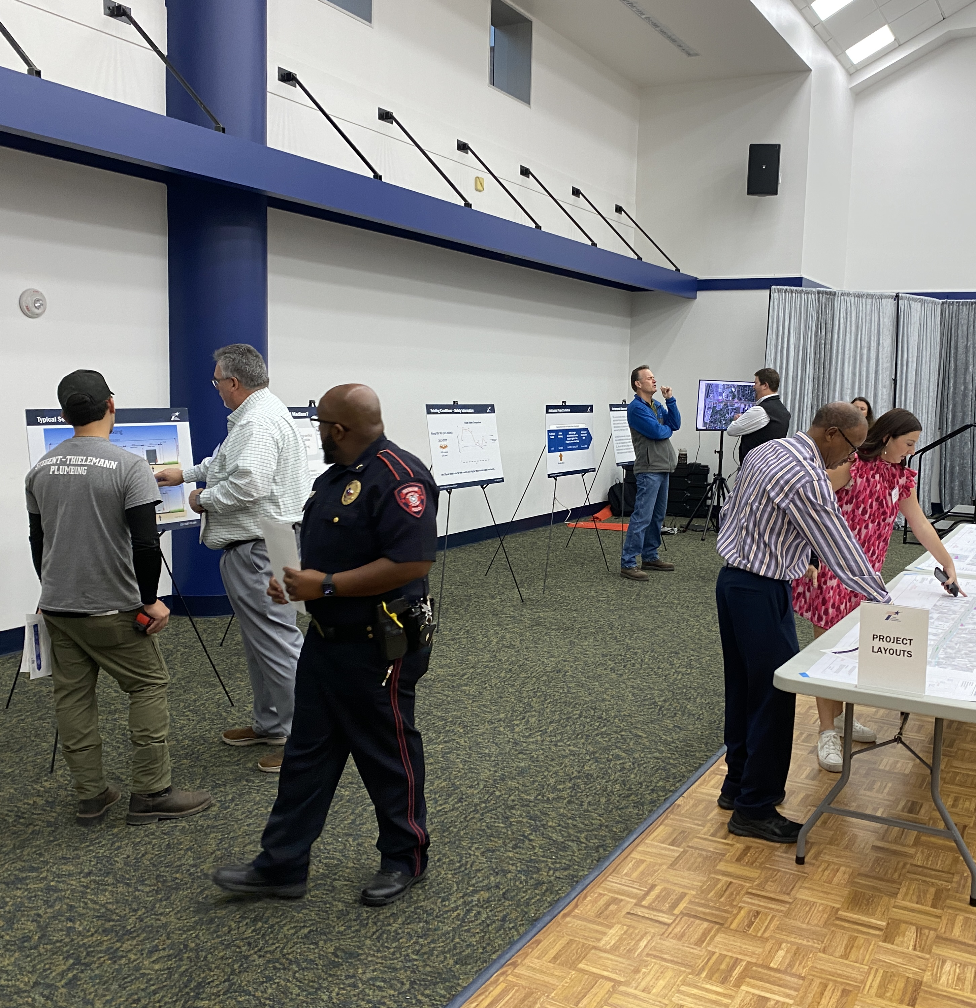
Key Takeaways
Overall concern with access to businesses
Project limits went too far north
Access into HEB didn’t align with parking
Access out of HEB could reroute traffic through neighborhoods
Expand project limits to include SH 36
→ Reduced Limits
→ Changed to main HEB drive aisle
→ Added a left-out opening
→ Expanded project

Slide 9
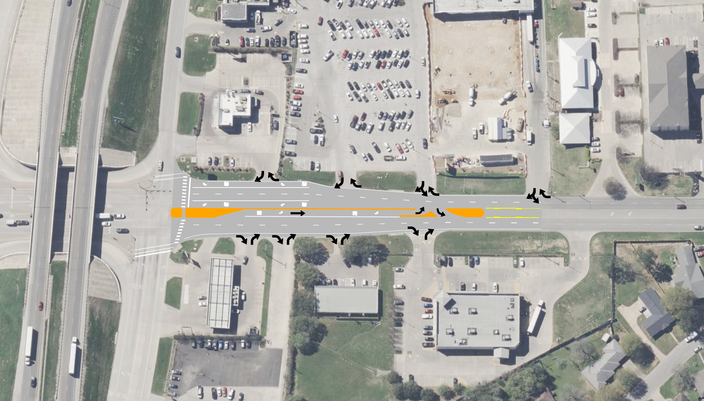
Proposed Draft Layout – South Day St.

Slide 10
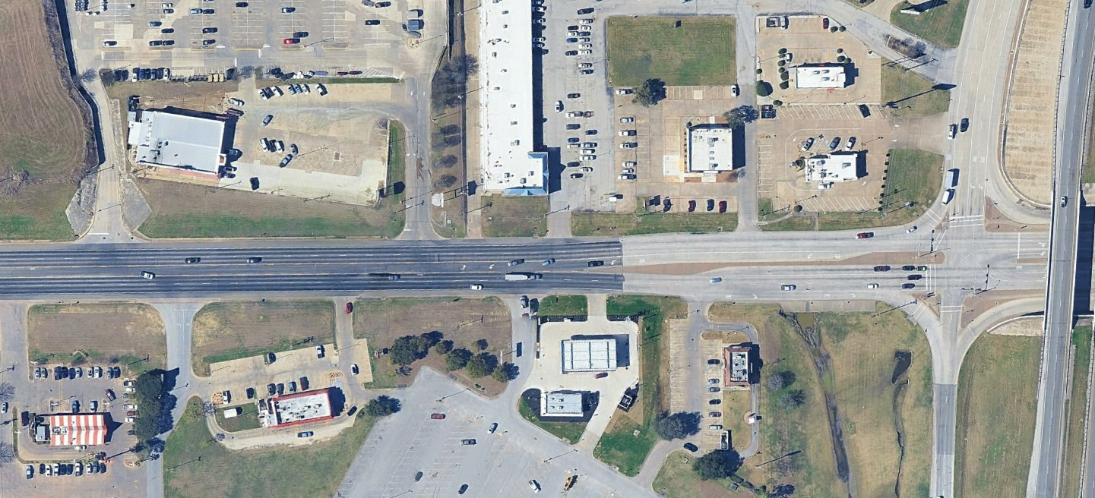
Current Roadway – SH 36

Slide 11
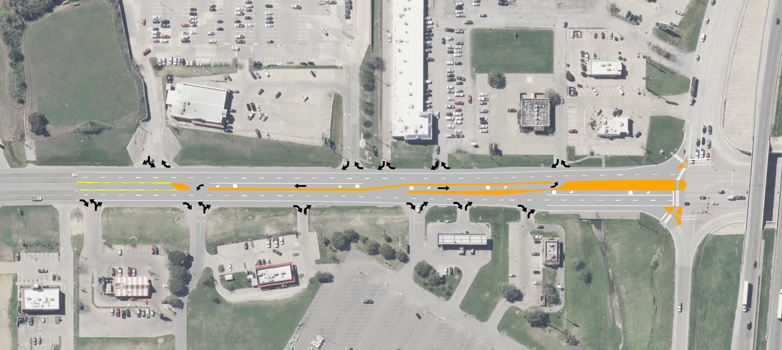
Proposed Draft Layout – SH 36

Slide 12
Next Steps
2023
Fall 2023
Fall 2025-Spring 2026
Preliminary Design
Public Meeting #1
Fall 2023 - Fall 2025
Update Design
Continued Stakeholder Feedback
Refine Design
December 2026
Tentative Project Bid Date
Public Meeting #2
We are here

Slide 13
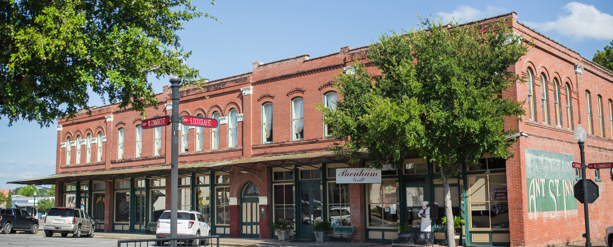
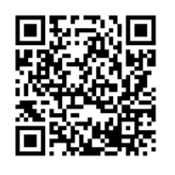
Bryan District Project Listing

