Slide 1
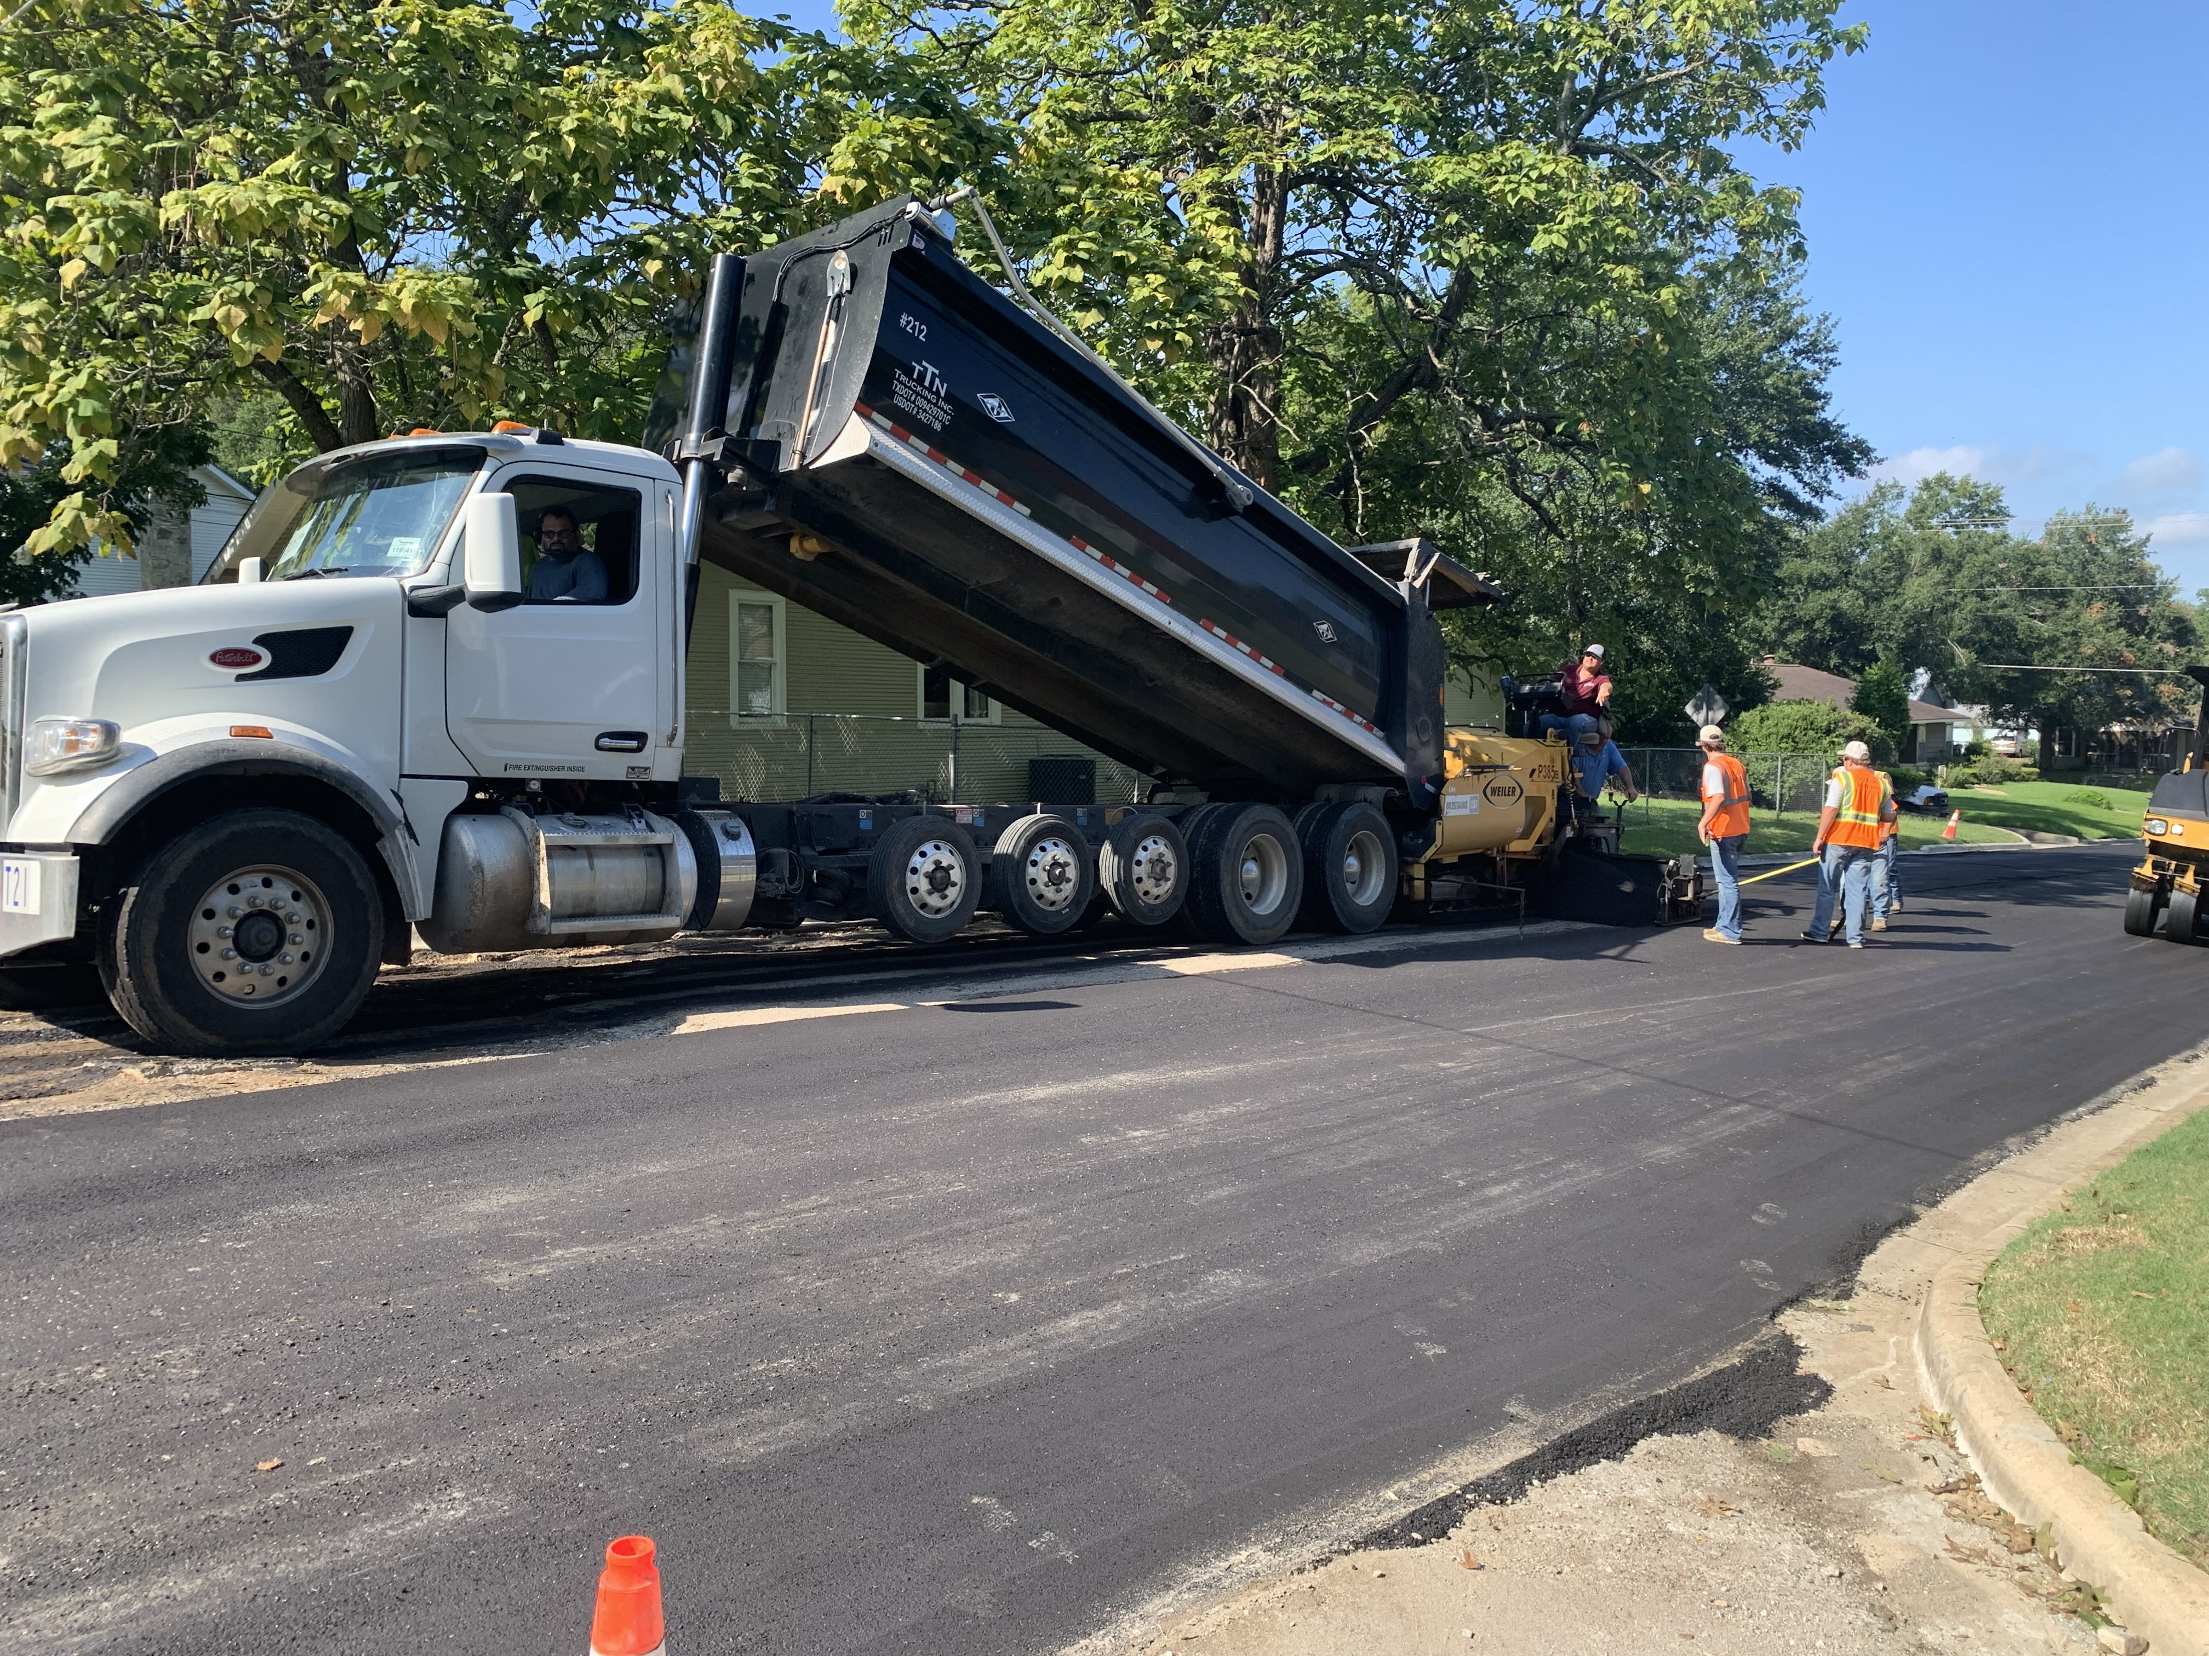
CITY OF BRENHAM
2026 Street Study Update

Slide 2
Street Study Background
City of Brenham maintains approximately 103 miles of streets
Over 90% are Asphalt
Remainder are concrete street sections
In the 2026 Street Study 89 miles were studied. The newer concrete sections were not studied as they are in great shape due to recent development.
The average budget for Street Maintenance activities has been $1.2M/YR over last 5 Yrs.

Slide 3
2020 vs 2026 Study
2020 2026
PCI 59% 57%
Backlog 14% 25%
PCI is the overall Pavement Condition Rating for entire system. (Goal of 70%)
Backlog is what percentage of streets fall below a PCI of 40. (Poor or Very Poor)

Slide 4
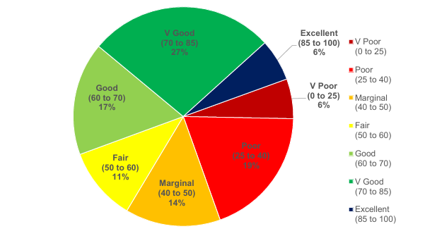
Overall Condition Rating
50% of Streets are listed in Excellent, V Good or Good
39% of Streets are listed in V Poor, Poor and Marginal
11% of Streets are Fair

Slide 5
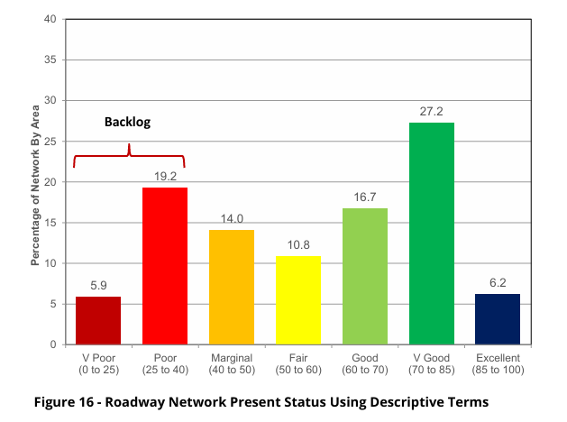
City of Brenham Network Distribution

Slide 6
Objectives from Study
In order to reduce backlog and increase PCI additional funds beyond $1.2M will need to be budgeted in future years.
This study allows staff to prioritize treatment of roadways focusing on maintaining V. GOOD and GOOD streets so less money can be spent overtime.
Outlines what roadways are beyond general maintenance and will need total reconstruction
Allows staff to take a 4-tier approach on improving roadways starting with basic maintenance all the way to reconstruction (crackseal, microcracking sealing, overlays and lastly reconstruction)

Slide 7
Roadways Reconstructed since 2020
2021 (1.25 mi) | 2022 (2.11 mi.) | 2023 (2.56 mi.) | 2024 (2.48 mi.) | 2025 (2.45 mi.) | 2026 (2.44 mi.)
Baylor St. (downtown) | N. Austin St. Baber St. | Pecan St. Bridge St. | Burch St. Clay St. | Sayles St. Cyndi Circle | Key St. N. Saeger St.
Bruce St. | Shepard St. | Johnson St. | Drumm St. | Michael Scott | Burleson
Cena St. | Carolyn St. | Armbrister St. | Cornish St. | Center St. | Jackson St.
Hidden Creek Ln. | Janet St. | Travis St. | Leghorn St. | Lounge Rd. | E. Alamo St.
Ledbetter Ln. | S. Baylor St. | W. Jefferson St. | Plymouth St. | Gilder St. | Wayside
Marjorie St. | Glenn Dr. | Kurtz St. | Wyandotte St. | Church St. | Leslie D.
Morgan St. | Rink St. | Ross St. | S. Chappell Hill St. | Mansfield St. | Navratil
Oak St. | Clayton Dr. | Bob St. | Emile St. | Goessler St. | Mansfield St.
Old N. Market St. | Cottonwood St. | Matilda St. | Hampshire Dr. | W. First St. | Munz St.
Seward St. | Liberty St. | Cambell St. | Hasskarl Dr. | Dark St. | Airline Dr
Salem Rd. (concrete) | Bryan St. Jersey St. | MLK Parkway (concrete) | Highview St. Lakeview St. | Heritage Dr. Carriage Dr. | Mae Way Allyne
Woodson Ln. | N. Saeger St. | Spencer St. | Jeffries St. | Century Circle | Loesch St
 | Hillcrest | Meadowbrook Ln | Key St. | S. Austin St.
 | OCH Rd. (concrete) | Rippetoe St. | Lubbock St. Tison St.

Slide 8
Contractor Projects Targeted
(Next 3-10 yrs)
Section To From Est. Costs
Stone St Market Austin $1.8M
Old Mill Creek Rd Saeger 290 Feeder $3.1M
Burleson St Blue Bell Rd Benton Dr $5.3M
N. Dixie Main St HWY 36 N $2.9M
N. Dixie City Limits HWY36 N $5.0M
Old Chappell Hill Rd City Limits WWTP $3.1M
Gun and Rod Rd Blue Bell Rd Cantey $2.6M
Gun and Rod Rd Stone St Cantey St $2.7M
Westwood Ln City Limits Dairy Queen $1.6M
S. Chappell Hill St Stone St Mansfield St $2.0M
Stone St S. Chappell Hill St Blue Bell Rd N/A

Slide 9
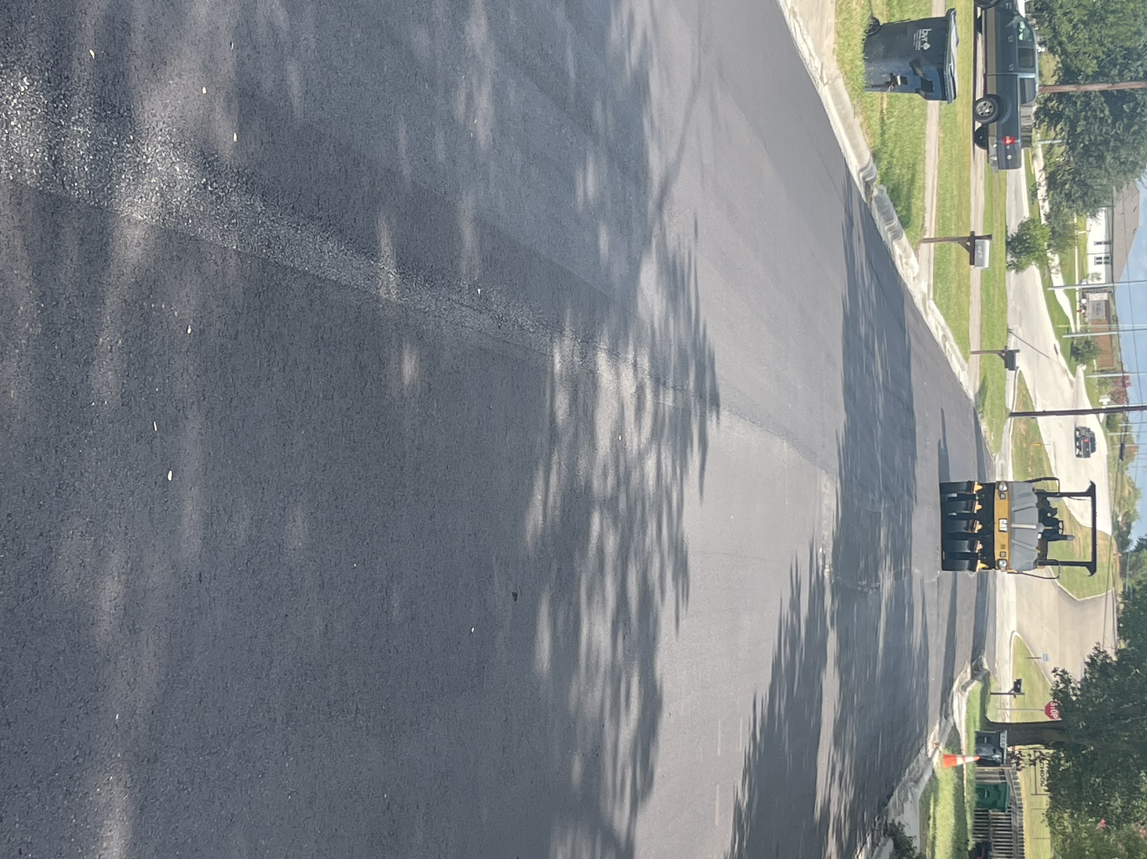
Street Work Pictures

Slide 10
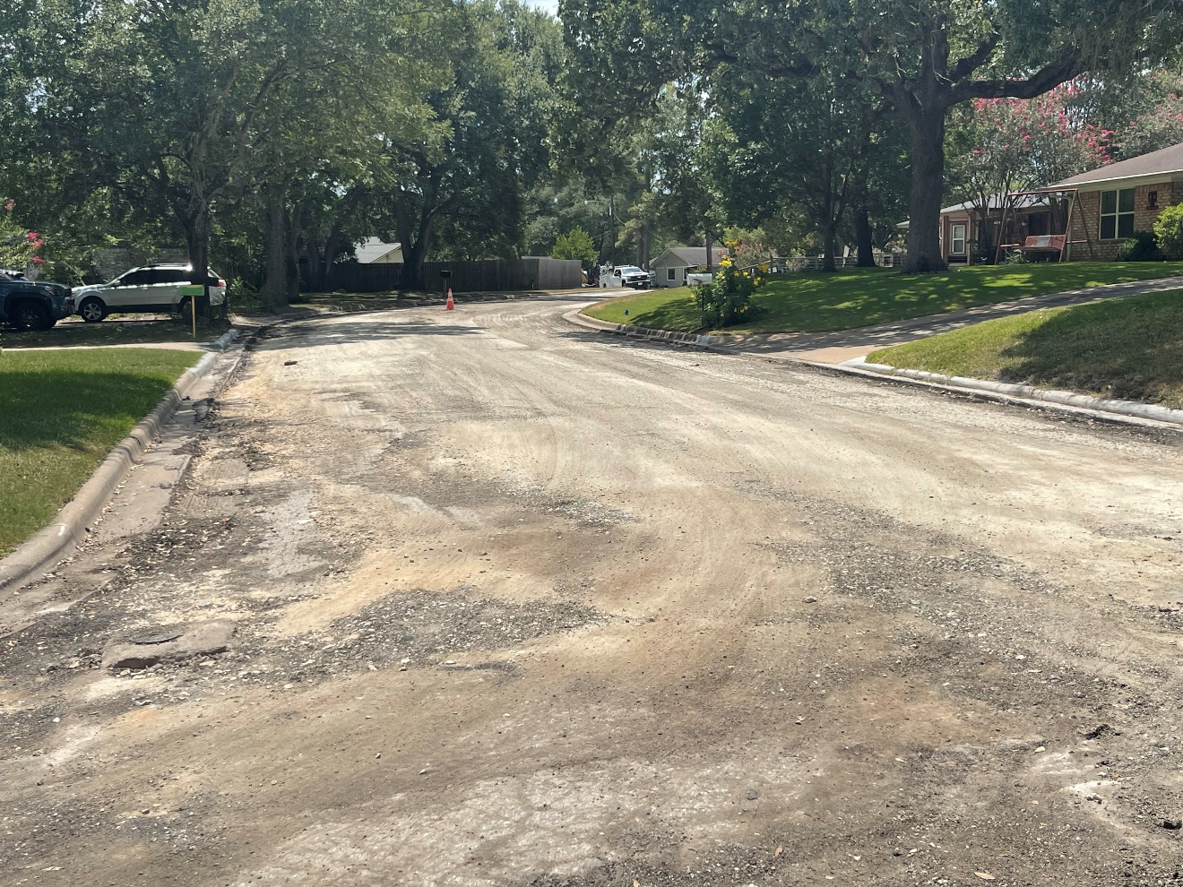
Munz St Prior to Paving
(Mill and Overlay Project)

Slide 11
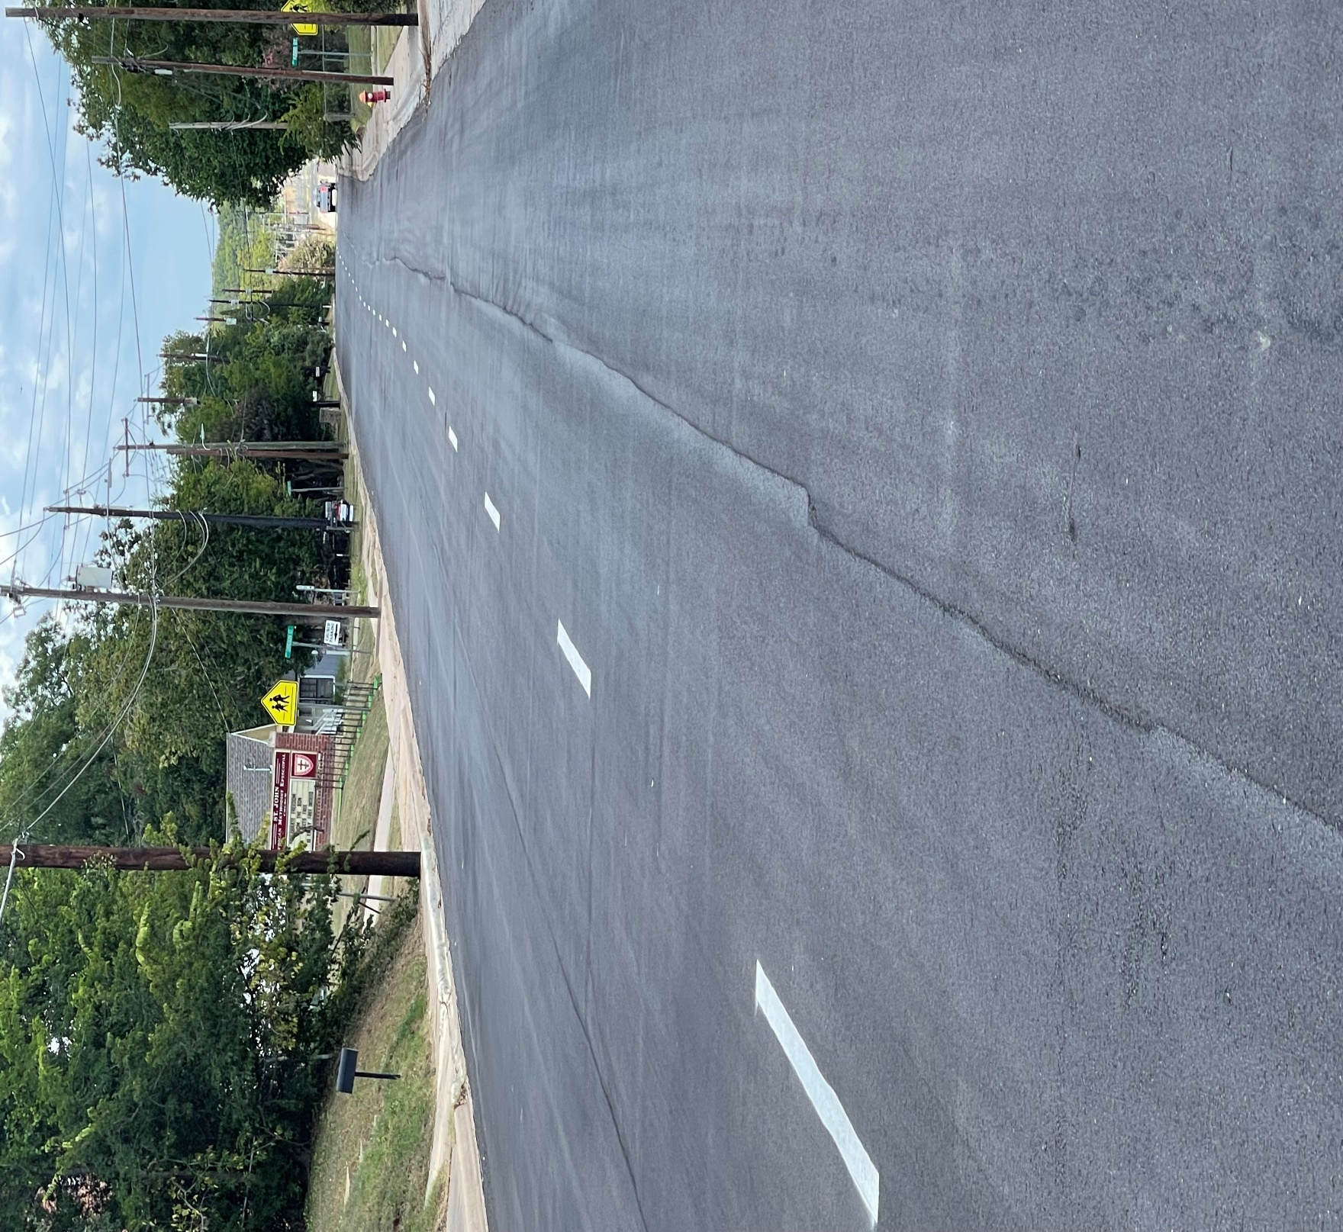
E. Alamo St Completed

Slide 12
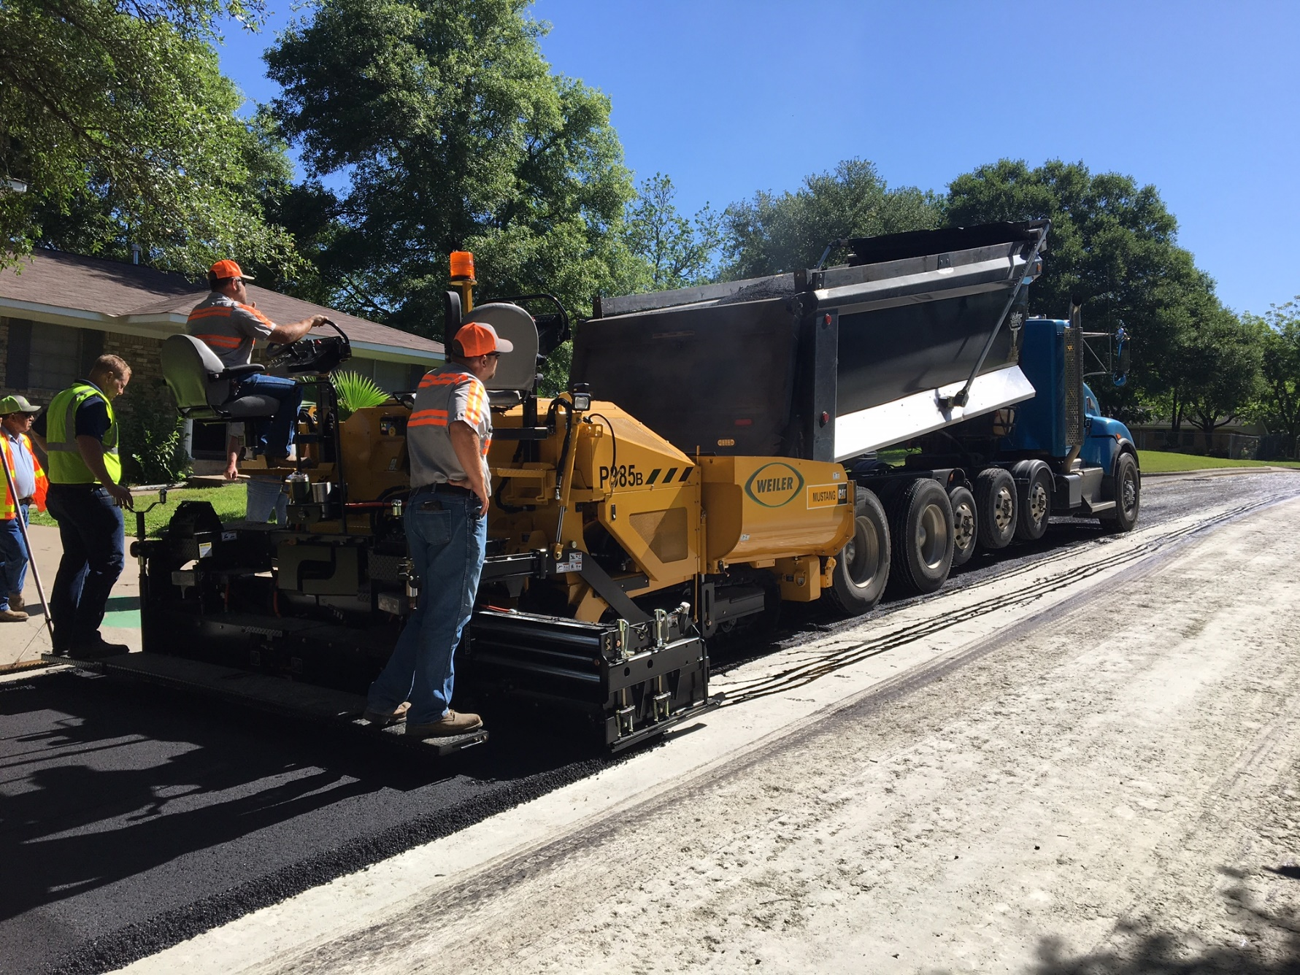
Asphalt Paver In Action

Slide 13
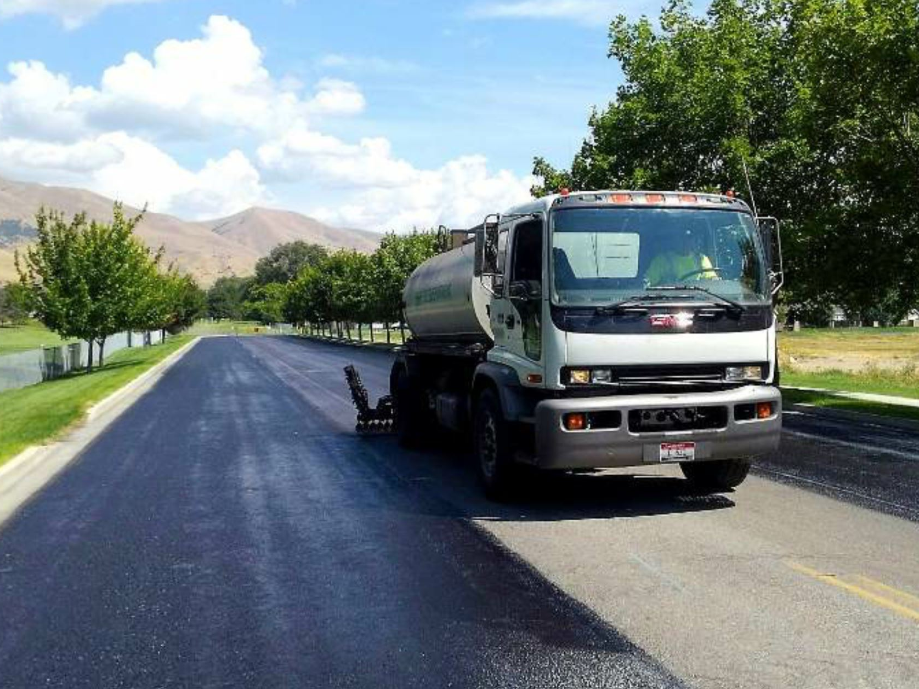
FOG Sealing

