Slide 1
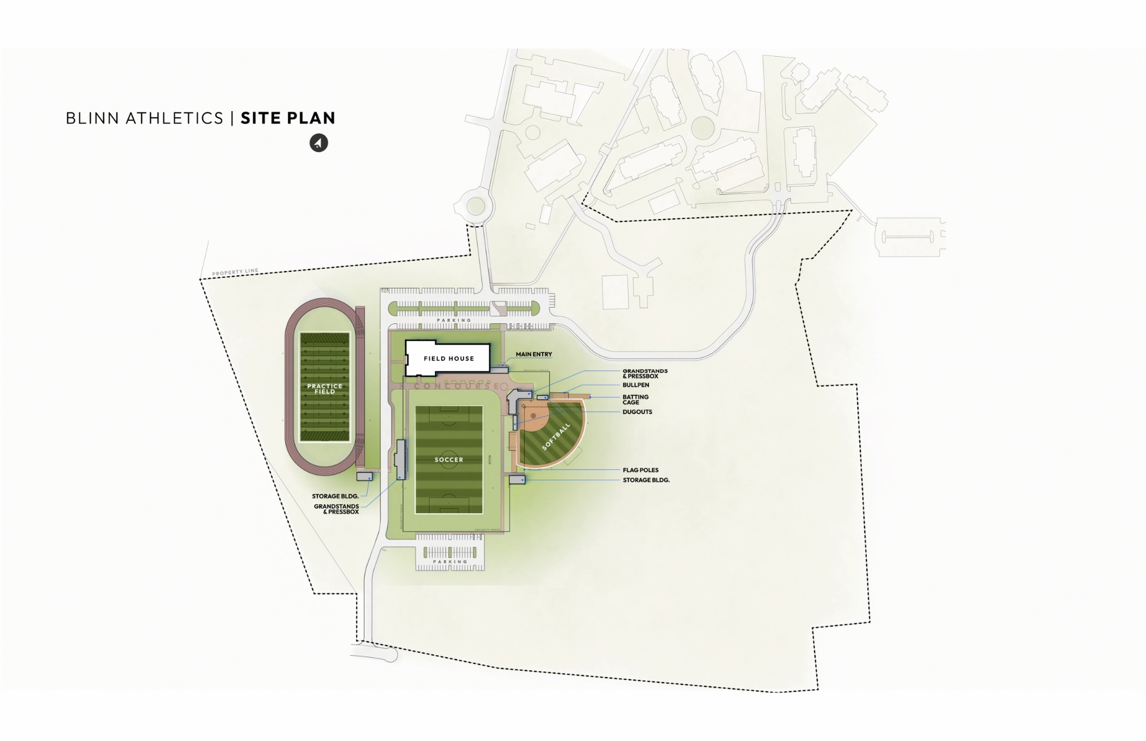

Recommendation
Blinn-Brenham Campus
Sports Complex
Notes:
1) 24’ wide drive, 8’ sidewalk and pedestrian ighting connection South Saeger St. to the Sports Complex, new fencing for ag pasture
2) Alternate bid 24’ wide drive to Oak Tree Crossing Dr. and 8’ sidewalk connections to Oak Tree Crossing drive the Blinn College Park Apartments
3) 24’ wide drive connection to Appel Drive.
4) 260’ bufferyard, underground electrical easement, and 80’ plus of landscape yard, screening with landscaping trees/shrubs and fencing, landscape buffer is larger than the distance between the backyard fences and the existing pasture fence
5) 250 parking spaces (increased from the previous 115) (approx. 170 north lot, 80 south lot)
6) 28,500 s.f. field house
7) Synthetic turf practice football field with lighting and an 8-lane all weather track
8) Synthetic turf competition soccer field with lighting, 600 shaded spectator seats and a press box
9) Synthetic turf competition softball field with lighting, 400 shaded spectator seats and a press box
10) Dry detention ponds
11) Contractor’s lay-down yard and construction entrance

Slide 2
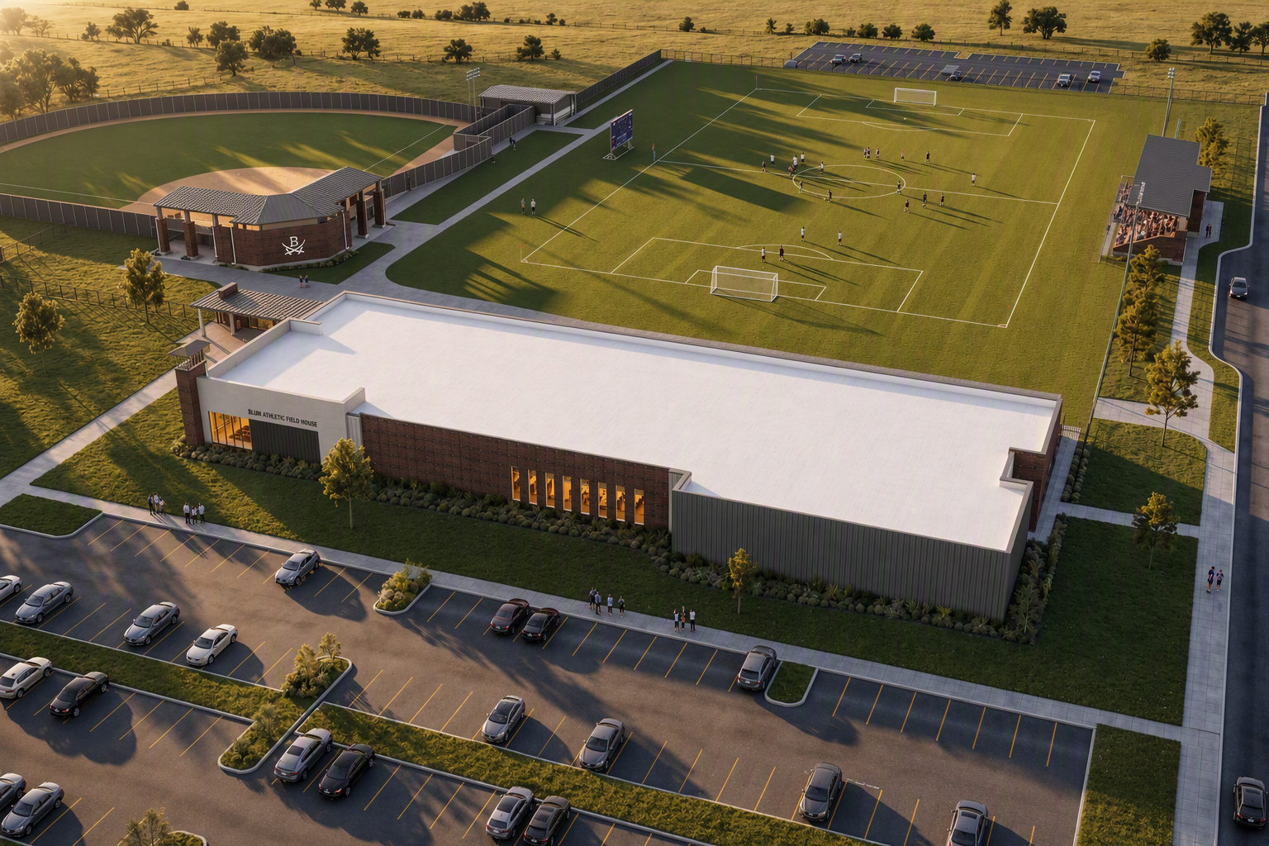
Recommendation
Blinn-Brenham Campus
Sports Complex

Slide 3
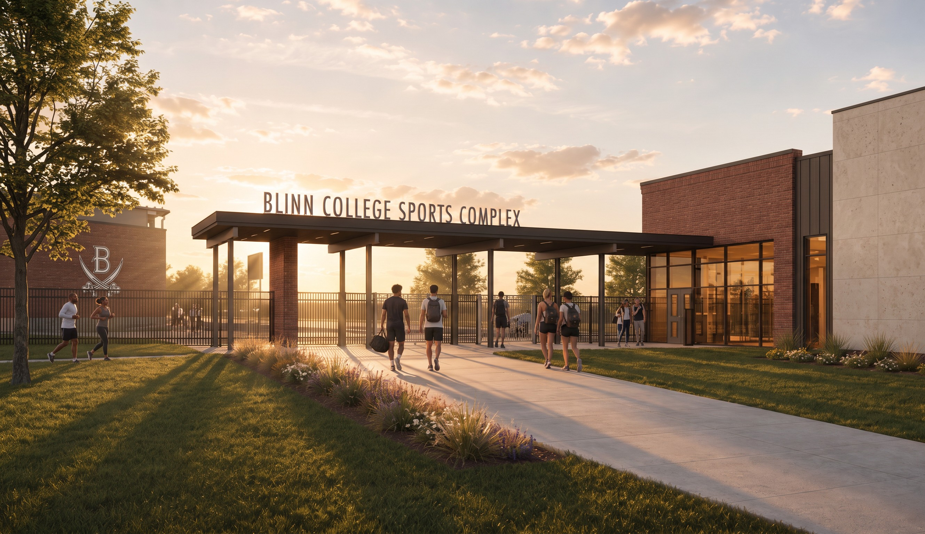
Recommendation
Blinn-Brenham Campus
Sports Complex

Slide 4
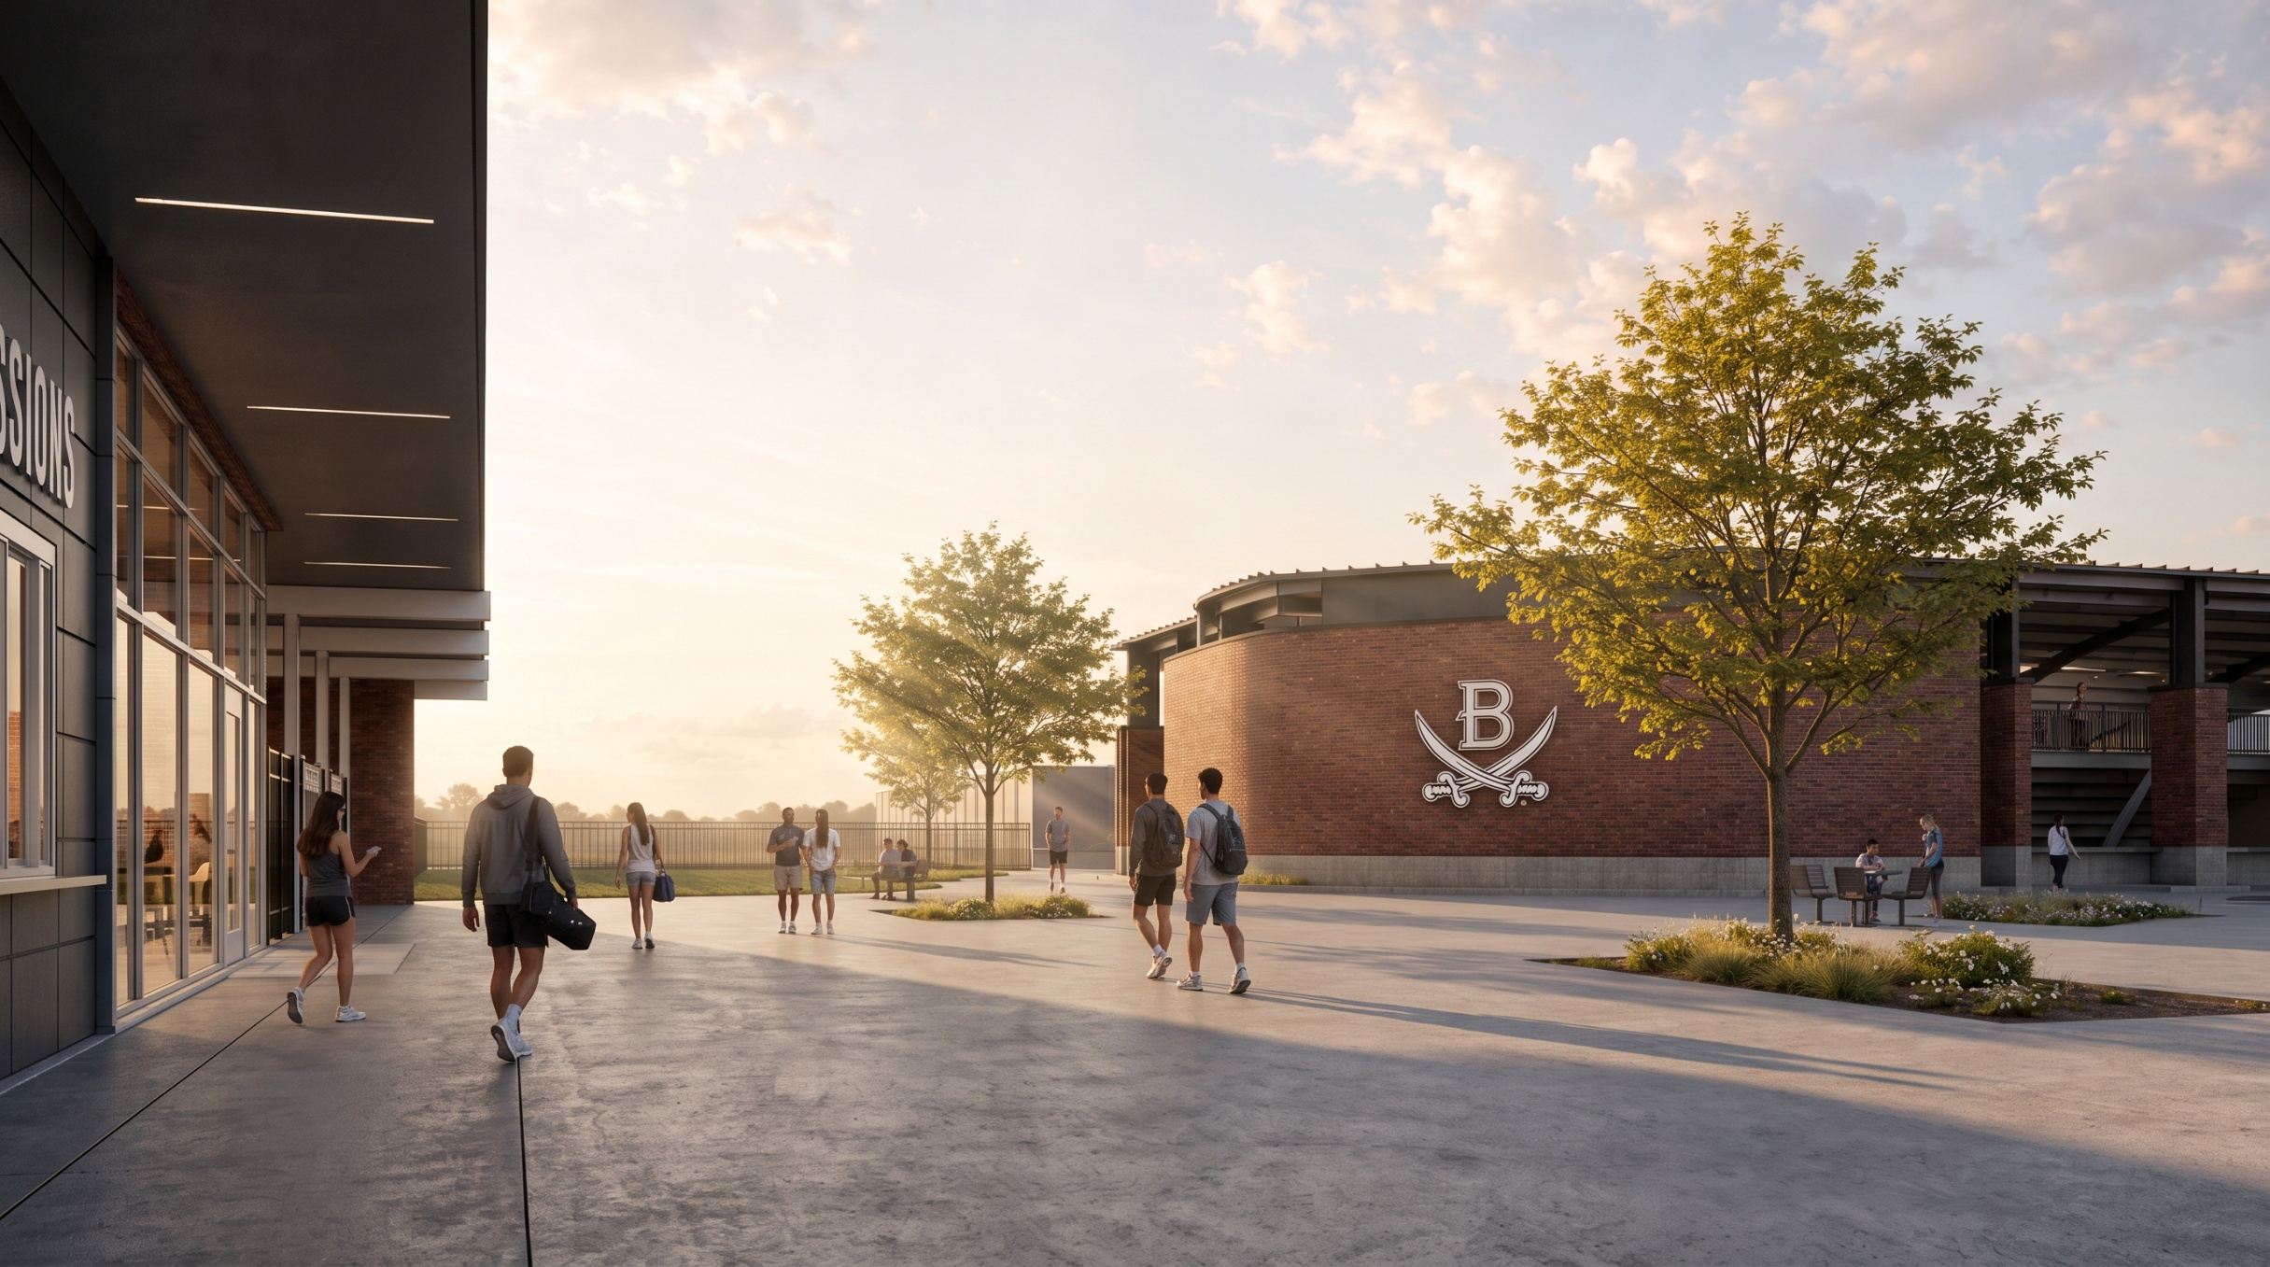
Recommendation
Blinn-Brenham Campus
Sports Complex

Slide 5
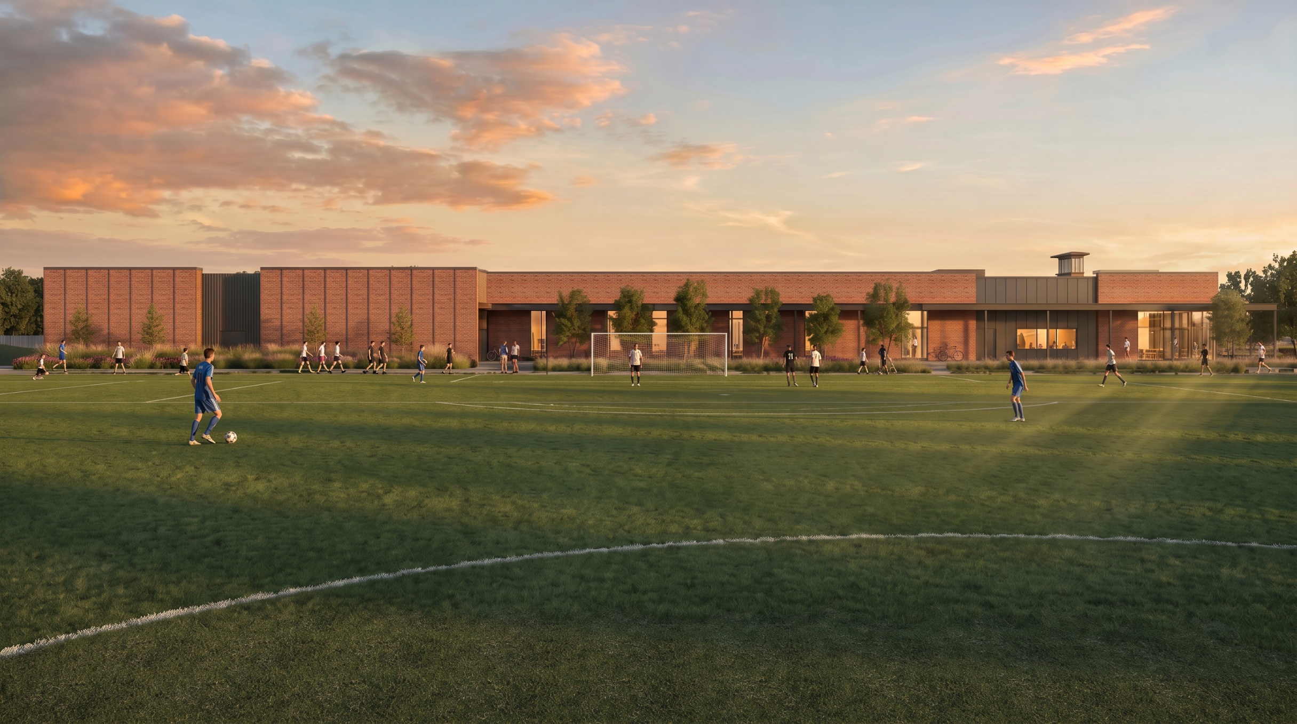
Recommendation
Blinn-Brenham Campus
Sports Complex

Slide 6
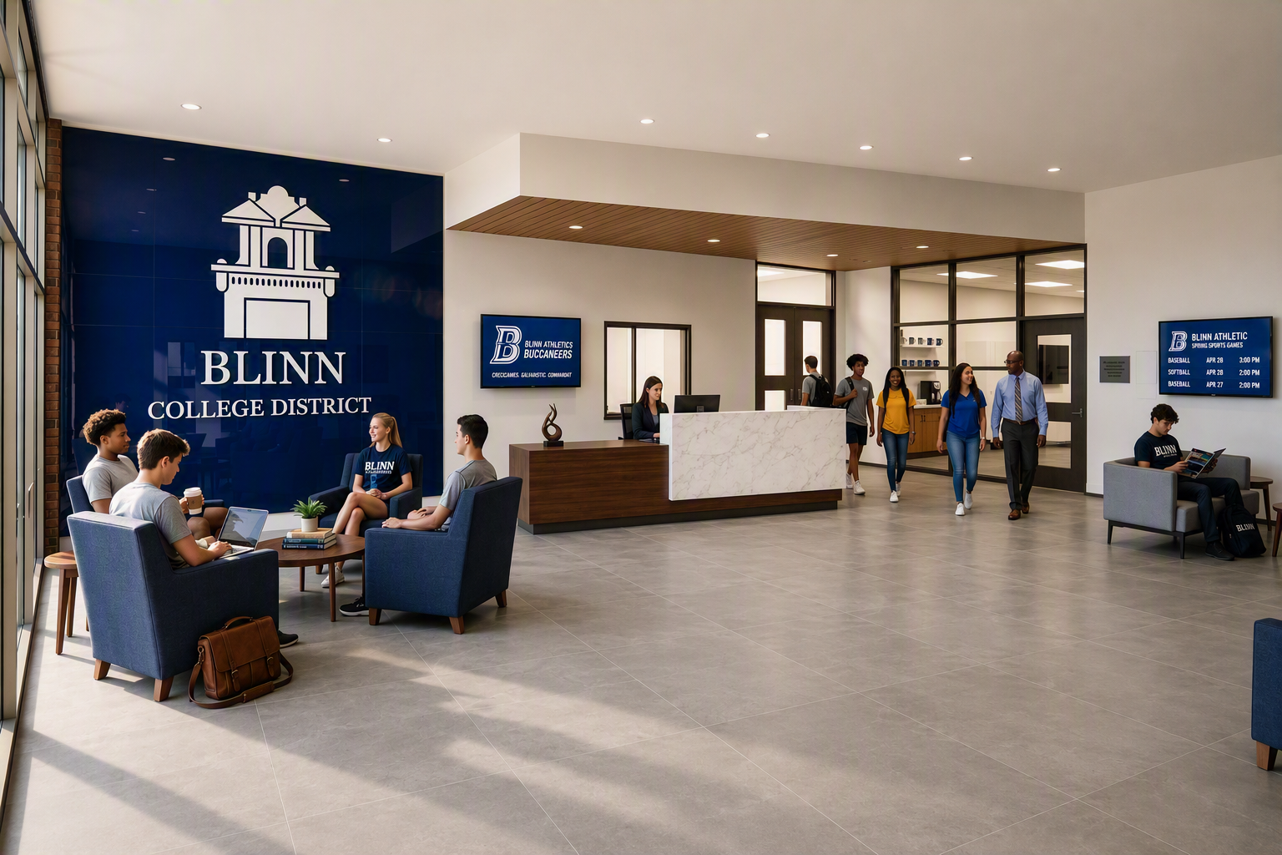
Recommendation
Blinn-Brenham Campus
Sports Complex

Slide 7
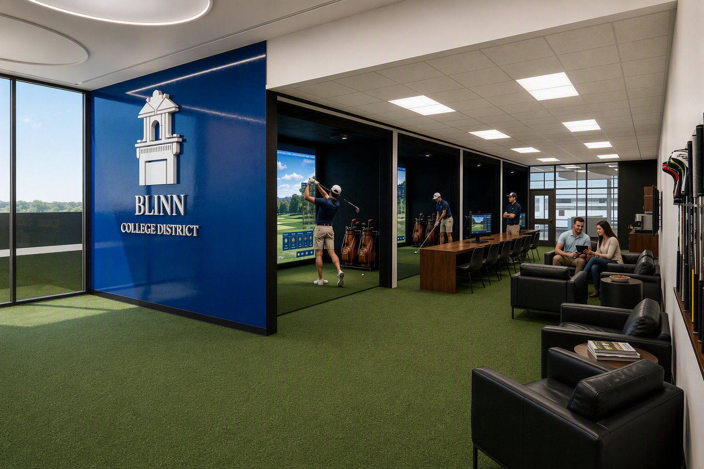
Recommendation
Blinn-Brenham Campus
Sports Complex

Slide 8
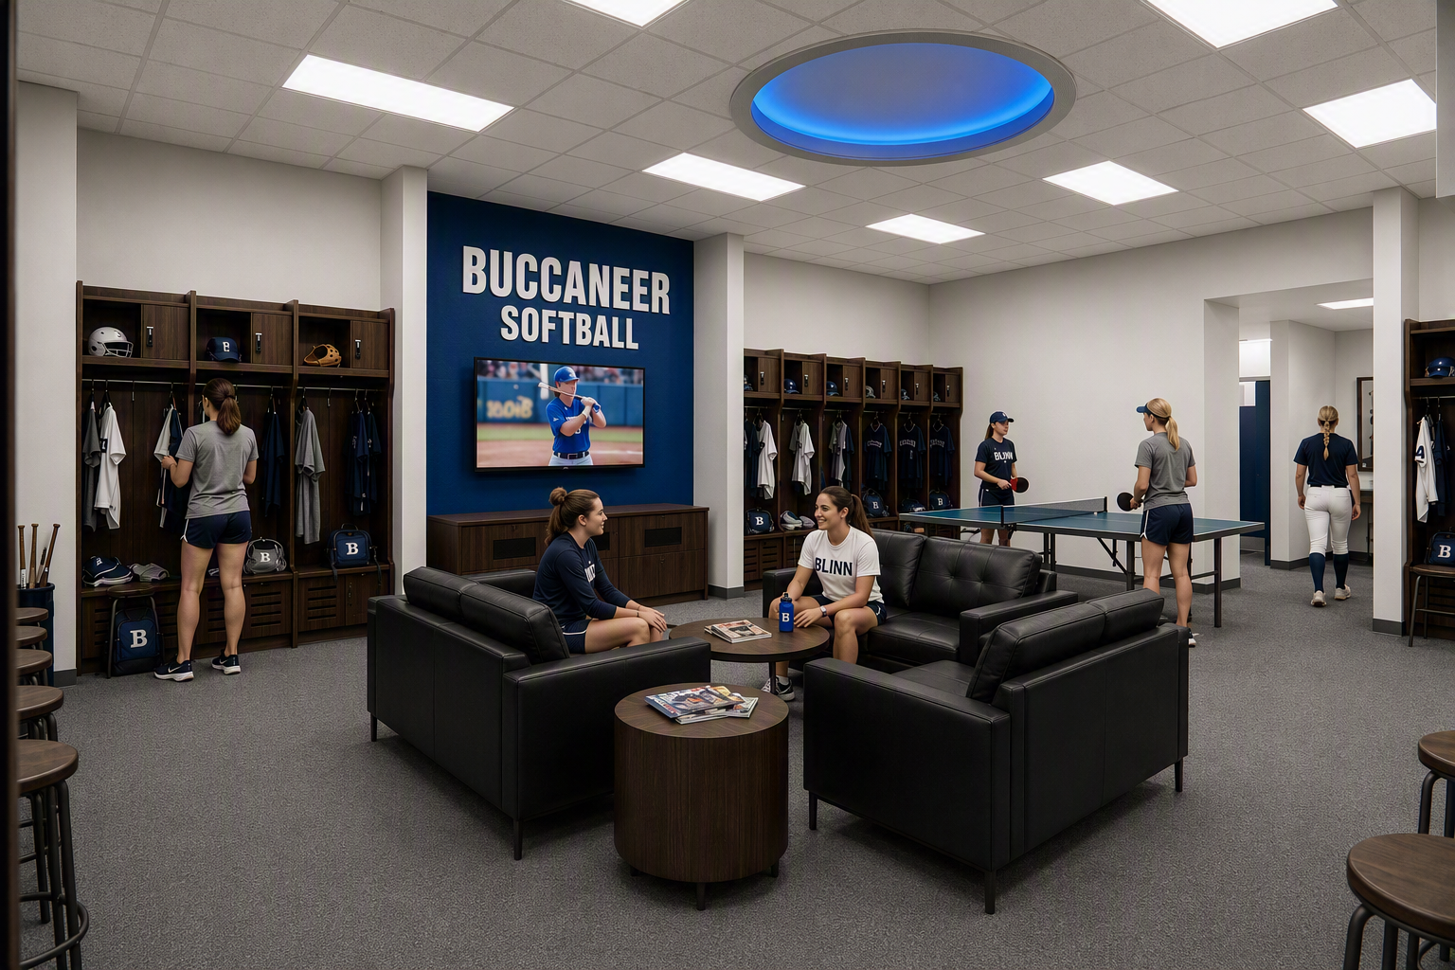
Recommendation
Blinn-Brenham Campus
Sports Complex

Slide 9
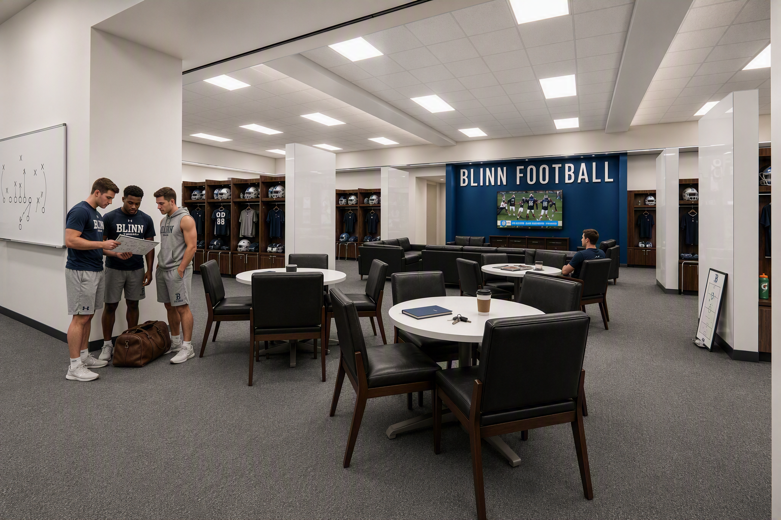
Recommendation
Blinn-Brenham Campus
Sports Complex

